Slide 1
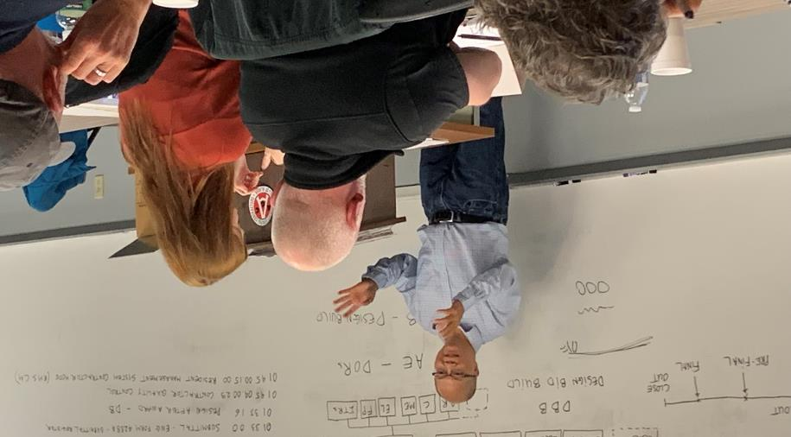
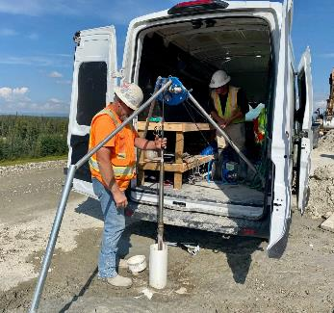
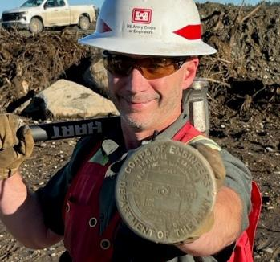
CONSTRUCTION QUALITY MANAGEMENT FOR CONTRACTORS
Xx-xx April 2024
TBD, ALASKA
Sample photo

Slide 2
Welcome
Construction Quality Management for Contractors (CQM-C)
Partnership with AGC
CQM is a SYSTEM required for USACE contracts to achieve required Quality
PLANNING, THINK PRO-ACTIVE, 3-PHASE CONTROLS, TESTING, SUBMITTALS, DEFICIENCY TRACKING, DOCUMENTATION AND SAFETY
Post-Test (70% is passing)
  - Certificates are valid for 5-years
Acronyms – keep your acronym sheet handy
Notes:
Our goal today and tomorrow is for this to be a good learning experience
We will be training you in the CQM SYSTEM which is required for USACE contracts.
For non-USACE contracts these UNIVERSAL principles still apply although terminology and process may be differ.
The system will also work for your home projects.
Post Test requires 70% to pass
Acronyms - keep your acronym sheet handy

Slide 3
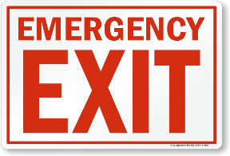



Welcome
Emergency Exits
Restrooms
Housekeeping
Silence Cell Phones
Notes:
Notes
Welcome to the Construction Quality Management for Contractors Course! Before we start…..
Housekeeping/Ground Rules for the Course
Location of Emergency Exits (Dependent on the Location on the Course - presenter of slide needs to figure this out prior to course start)
Location of Restrooms (Dependent of the Location of the Course – presenter of slide needs to figure this out prior to course start)
Housekeeping –Please Keep Room Clean (Drinks and Food are allowed however, please place garbage in designated areas) – May be dependent of the Location of the Course – Presenter of slide needs to figure this out prior to course start)
Please Silence Cell Phones – If you need to take a call please leave the room.

Slide 4
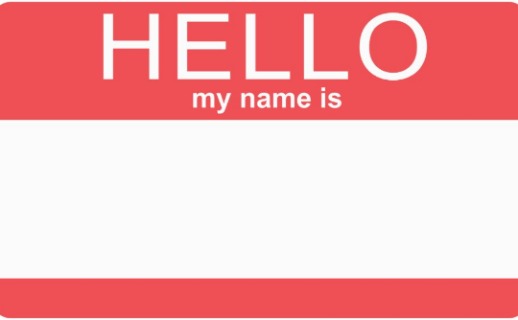
Student introductions
Name
Current employer
Number years working at current employer
Experience in CQM
Hobby or interest
Notes:
Pointer: Do Student Introductions First – Take Notes to get a feel of your audience to better cater to the class. (i.e. how many newbies, how many experienced folks, etc.,)

Slide 5
Instructors
Role | Name | Work Number | Work E-mail
Course Instructor
 | Ryan Booher | (907) 753-2764 | ryan.e.booher@usace.army.mil
 | John Dutton | (907) 377-4049 | John.V.Dutton@usace.army.mil
 | Jason Eckstein | (907) 753-2881 | Jason.C.Eckstein@usace.army.mil
 | Cole Jacobson | (907) 753-5651 | Cole.V.Jacobson@usace.army.mil
 | Colleen Jordan | (907) 753-2888 | Colleen.L.Jordan@usace.army.mil
 | Tuan Lai | (907) 753-5500 | Tuan.Q.Lai@usace.army.mil
 | Chuck Livers | (907) 753-2698 | Charles.J.Livers@usace.army.mil
 | Karey Park | (907) 753-2523 | karey.h.park@usace.army.mil
 | Andrew Posma | (907) 356-6712 | Andrew.J.Posma@usace.army.mil
 | Saundra Ward | (907) 201-5137 | Saundra.L.Ward@usace.army.mil
District CQM Course Manager | Marion Dawag | (907) 753-5640 | Marion.E.Dawag@usace.army.mil
Division CQM Course Manager | Ed Yago | (907) 835-4682 | Edward.M.Yago@usace.army.mil
Notes:
Current list of USACE CQM Instructors.
Introduction of the Instructors (use same student introduction format)
Name
Number Years working at USACE
Experience in CQM
Hobby/Interests

Slide 6
AGENDA
DAY 1
Welcome/Introductions
Pre-test
Module 1
Module 2
Module 3
Module 4
Module 5
Module 6 (Submodule 6.1)
DAY 2
Module 6 (Submodule 6.2, 6.3, 6.4, 6.5)
Module 7
Module 8
Review
Post-test
Course Evaluation
Notes:
Notes:
There is no set time frame for each module/task.
There will be 10-15 minutes breaks throughout the day. Breaks can be after each module lecture or whenever a break is needed.
There will be an hour lunch each day. Again, this is dependent on where we are on each module.

Slide 7
Pre-test
Notes:
Closed book
Closed neighbor
Score does not matter
Read the questions carefully, make a mental note of vocabulary you might not be familiar with

Slide 8
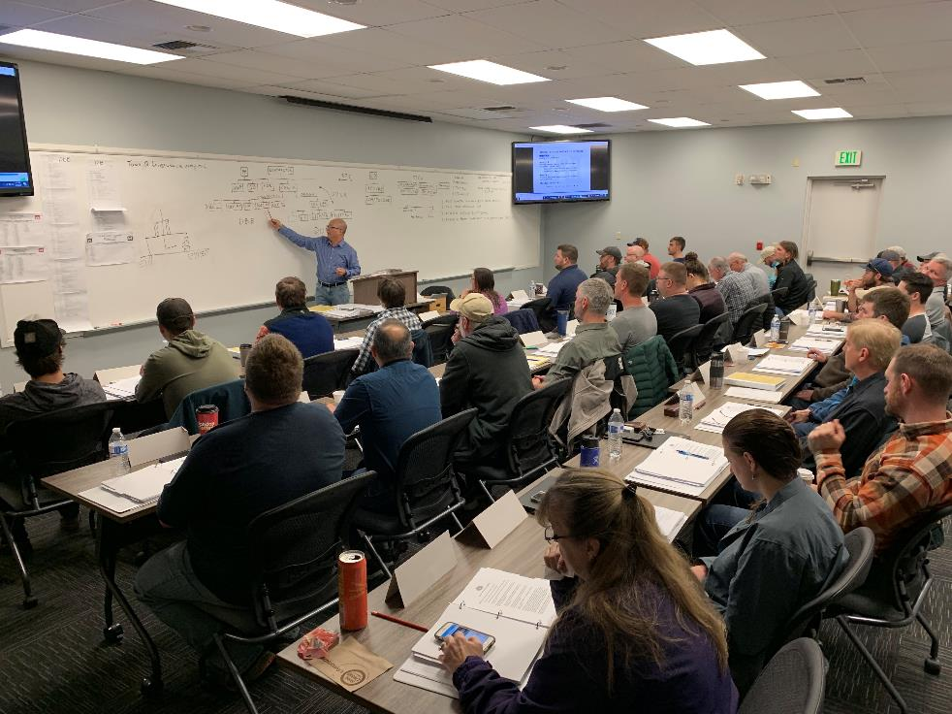
Course overview

Slide 9
Course material
Module 1: An Introduction to CQM
Module 2-6:
    Various Reviews
    Plans
    Conferences
    Reports
    Management Requirements
Module 7: Making the CQM System Work
Module 8: Overview of RMS
Module 9: NAVFAC’s eCMS (Not covered in this course)
Notes:
Review layout of Student Study Guide, Modules and sub-modules
Module 1, history, definitions, procedures, benefits; construction industry and the responsibilities of the Government and the contractor.
Modules 2 through 6, the various reviews, plans, conferences, reports, and management requirements are described.
Module 7, discussion of the ways and means of making the CQM system work effectively
Module 8, is an overview of the Resident Management System (RMS)..to be presented at USACE sponsored courses.
Module 9, covers NAVFAC’s Electronic Construction and Facility Support Contract Management System (eCMS), and will be presented at NAVFAC

Slide 10

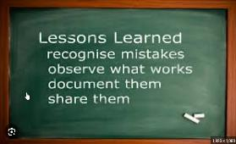


Expectations for students
Participate in class discussions
Share lessons learned from your career
Complete course evaluation survey (end of course)
Read the Student Study Guide

Slide 11

BEFORE WE GET INTO THE WEEDS
Quality
Quality + Time + Cost
This can be achieved!
Time
Cost
Notes:
Take a step back and think about what the three-part goal
Quality + Time + Cost => can be achieved!
How do we do it? Next Slide

Slide 12
Introduction
Module 1
Notes:
Module 1 Topics
1.1 What is Construction Quality Management (CQM)
1.2 Contractor Quality Control
1.3 Contractor and Government Responsibilities

Slide 13
What is Construction Quality Management?
Sub-Module 1.1

Slide 14

OBJECTIVES
State the purpose of Construction Quality Management (CQM)
Discuss the reasoning behind the USACE/NAVFAC policy on CQM
Discuss various characteristics that are specific to the construction industry
Define Contractor Quality Control (CQC)
Define Government Quality Assurance (QA)
Pg 4

Slide 15
HISTORY oF CQM
1961 new clause required contractor to be responsible for achieving and documenting construction quality
By 1968 system was loosely structured and variable
Various approaches over the years
With input of industry partners (AGC) system evolved to the relatively structured process we have today.
Pg 5
Notes:
Ask – what are some of these “structured processes” associated with CQM, based on your experience?
Three phase control system,
formal deficiency /rework items tracking systems, and
well-defined submittals.
Required plans like the Quality Control Plan
USACE and NAVFAC specify the contractor’s manpower quantity and qualifications.
This training for contractor personnel is now a contract requirement.
Ask – are these choices free?
Ask – Are they part of the contract?

Slide 16
quality Management – business practice (iso9000)
Quality depends on a set of inherent characteristics and a set of requirements and how well the former complies with the latter.
    Quality control => activities intended to ensure that quality requirements are being met. Not just comparing/checking but PLANNING for quality and CORRECTING DEFICIENCIES and then PREVENTING FUTURE DEFICIENCIES
    Quality assurance => activities intended to ensure that Quality Control is effective
Supplier QC
Contractor QC
Construction Site
Gov’t QA
Subcontractor QC
District QA
Notes:
Quality Control is integral to daily life and can be found in nearly all business subjects.
Quality:
Inherent characteristics of the product produced.
Requirements of the product
Compare and determine if these characteristics comply with the requirements.
Quality Control is the set of activities to ensure the inherent characteristics meet the requirements.
(So it not just comparing or checking but also taking the action necessary to plan for quality and then to correct deficiencies)
Quality Assurance is the set of activities conducted to ensure QC is working effectively

Slide 17

Coffee cup example
Requirements:
  What are your requirements are for a paper coffee cup and lid?
Characteristics:
  How would you determine the characteristics of the cup?
  Quality – Have we achieved the required quality?
Notes:
Divide the class into 2 parts
Ask side 1 (coffee cup engineers) - what are their requirements for the coffee cup?
No leaks
Keep hot (max 20 degree drop after 10 minutes)
Stable
Does not burn hands
Does not crush when gripped by a human hand
Ask side 2 (coffee cup builders) – if you were building the cup how would you CONTROL the characteristics?
Submittals for the materials (paper, coatings, glues)
Tests
RFIs
Visit to the paper factory
End-product testing
Quality – Do the characteristics of the coffee cup meet the requirements?

Slide 18
CONSTRUCTION QUALITY Management
The performance of tasks which ensure that construction is performed according to the plans & specifications on-time within a defined budget and safe-working environment
Key components:
QC: assure that the completed project meets all quality requirements of the contract
QA: assures that CQC is working effectively
Quality: meeting the contractual requirements
Quality
Be Proactive vs Reactive!
Time
Cost
Pg 5
Notes:
Ask – what is the main goal of CQM?
construction is performed according to the plans & specifications on-time within a defined budget and safe-working environment
Ask – What is required to achieve that goal? Pro-active
- predict issues/ deviations before they occur versus being reactive and fixing issues after they product has been finished.
Ask – Is being pro-active the responsibility of the government, contractor or both?
Ask – So, what can go wrong and how do we plan to avoid that from happening?
- plan, review repetitive deficiency list, follow and enforce the system

Slide 19
Federal Acquisition Regulation (FAR)
Representative Contract clauses that have a role in Construction Quality Management
Over 25 contractual clauses and requirements, the most important of which is
  52.236-3 SITE INVESTIGATION AND CONDITIONS AFFECTING THE WORK (APR 1984)
  52.236-5 MATERIAL AND WORKMANSHIP (APR 1984)
  52.236-21 SPECIFICATIONS AND DRAWINGS FOR CONSTRUCTION (FEB 1997)
  52.246-12 INSPECTION OF CONSTRUCTION (AUG 1996)
    (b) The Contractor shall maintain an adequate inspection system and perform such inspections as will ensure that the work performed under the contract conforms to contract requirements.
    (d) The presence or absence of a Government inspector does not relieve the Contractor from any contract requirement, nor is the inspector authorized to change any term or condition of the specification without the Contracting Officer's written authorization.
Authorities, responsibilities and allocation of risk
  FAR (Federal Acquisition Regulation) https://www.acquisition.gov/browse/index/far
Notes:
Ask – where in the contract would you find the clauses?
Front end
Ask – what is another name for the location of the clauses?
Boiler plate
Ask – what is the purpose of clauses?
Establish authorities,
Assign responsibilities
Allocation of risk

Slide 20
Construction management CHALLENGES
Government(Gov):
Managing multiple contracts simultaneous
Ensure contract requirements are being met
On time, within budget, with high quality, safely
Customer requirements
Coordinate other gov’t entities
Administration
Contractor (Ktr):
Manage personnel / subcontractors
Ensure contract requirements are being met
Execute contract timely, stay feasible/ cash flow, required quality, safely
Manage resources
  (i.e. continuous work & new contracts)
Specialization in Trades due to increased Technology and Regulation
Pg 6
Notes:
Ask what additional challenges would you add to either list?
Contractor: Financing projects with changes/ modifications
Government: Incorporating late user requested changes with little impact on the project time & budget

Slide 21
quality management benefits
Government (Gov):
Early control and detection prevents future delays
“Our money’s worth” (time, cost, quality)
Safe environment
Contractor (Ktr):
Increase profit and production
Better communication/ planning/ coordination
Good evaluation by Gov
Pg 6
Notes:
Ask what additional benefits would you add to either list?
- safety
- pride in a quality product
- street cred

Slide 22
Useful References
Engineering Regulation ER1180-1-6 “Construction Quality Management”
  Provides minimum requirements for USACE personnel in performing effective CQM in the field
Engineering Pamphlet EP 715-1-2
  A Guide to Effective Contractor Quality Control (CQC)
Whole Building Design Guide - https://www.wbdg.org/
  Publications and Specifications
  Industry Standards
Quality
Time
Cost
Notes:
The intent with this slide is to highlight that USACE and NAVFAC publications are available as resources to better understand what the Government expectations are when it comes to contractor quality control.

Slide 23
Supplemental Material (Dropbox)
Key Division 1 Specifications (guide and project specific)
Student Study Guide (SSG)
Course Presentation Slides
CPARS Rating Definitions – Performance Ratings
EM385-1-1 – Safety Manual and Requirements
EP 415-1-261 – Quality Assurance Guides
Example Activity Hazard Analysis (AHA)
*This Dropbox is provided by AGC after class conclusion.
Notes:
In addition to the useful QC reference documents, there are additional examples and materials available for future reference on USACE jobsites.

Slide 24
Module 1.1 Conclusion
Construction presents complex and difficult challenges
Challenges require the best tools which includes CQM
CQM requires combined effort of QC and QA personnel
    Safe work environment
    Quality construction on time on budget
Proactive vs reactive. Plan for success!
Success achievable through joint implementation of CQM
Quality
Time
Cost
Pg 8

Slide 25

MODULE 1.1 CLASS work
Review Module 1, Submodule 1
Answer questions # 1-8
20 Minutes
Pg 9

Slide 26
MODULE 1.1 question #1
Question #1 - In construction, what establishes the quality requirements?
Answer #1 - The quality requirements are established by the plans and specifications (contract documents).

Slide 27
MODULE 1.1 question #2
Question #2 - What is the purpose of CQM?
Answer #2 - The performance of tasks, which ensure that the construction is performed according to plans and specifications.

Slide 28
MODULE 1.1 question #3
Question #3 - define CQM?
Answer #3 - CQM is the performance of tasks, which ensure that construction is performed: according to plans and specifications, on time, within a defined budget, and in a safe work environment

Slide 29
Question #4 - What are the two principal areas of CQM activity? Define eacH.
MODULE 1.1 question #4
Answer #4
Contractor Quality Control - The primary function of contractor quality control (CQC) is to assure that the completed project meets all quality requirements of the contract.
Government Quality Assurance - Through reviews, inspections, and tests, the Government assures that CQC is working effectively, and that the product complies with the quality established by the contract.

Slide 30
Question #5A - What are the benefits of CQM to the contractor?
MODULE 1.1 question #5a
Answer #5A
To the contractor, the benefits of CQM are
increased profit and production,
better communication, planning, improved organizational skills and
outstanding performance evaluations to obtain future contracts.

Slide 31
Question #5B What are the benefits of CQM to the Government?
MODULE 1.1 question #5B
Answer #5B
To the Government, the benefits of CQM are many:
Work is performed according to plans and specifications;
On time;
Within a defined budget;
Easily maintained; and
A safe work environment.
This can be summarized as “getting our money’s worth”.

Slide 32
Question #6 - What two factors have caused the construction industry to become highly specialized?
MODULE 1.1 question #6
Answer #6
Increased Technology
Regulations

Slide 33
Question #7 Why are construction projects difficult to manage?
MODULE 1.1 question #7
    Answer #7
    Unique by nature making standardization difficult;
    Involve many skills that are non-repetitive and do no lend themselves to an assembly line approach;
    To a large degree dependent upon environmental conditions, which are beyond the contractor’s control; and
    Subject to varied regulations from numerous Government agencies.

Slide 34
Question #8 - What factors will influence both the Government and the construction industry in future?
MODULE 1.1 question #8
Answer #8
Influencing factors will be:
New Government regulations;
greater client/customer influence;
improvement of QC and QA requirements;
the increased use of construction-oriented management information systems;
formal partnering involving all stakeholders;
increase in contractual requirements for exchange of data in electronic format;
increased performance-based requirements, less prescriptive;
more reliance on design-build; and
more consideration of life-cycle requirements as opposed to just construction.
Resources
Trained workforce
Cyber security

Slide 35
Contractor Quality Control
Sub-Module 1.2
Notes:
Sub-module 1.2 Contractor Quality Control
“inspection” vs “control”
Responsibilities in CQM
Describe the benefits of CQC

Slide 36
OBJECTIVES
Differentiate between “inspection” and “control”
Describe, in general, the contractor’s and Government’s responsibilities in CQM
Describe the benefits of CQC to the Contractor, the Government, and the client/customer
Pg 10
Notes:
Emphasize that control comes before inspection

Slide 37
Control vs. inspection
QC
Preventative
Potential deficiencies
Continuous Planning
Cost
On-going/ after the fact
Identifying issues
Continuous Examining
Control
Inspection
Activity Progression
Pg 10
Notes:
The purpose of this slide is to illustrate the differences between ‘Control’ and ‘Inspection’.
Time and cost impacts increase significantly while the work is being performed (purple line …). So, the earlier the problem is identified, the less time/money/ efforts are required to deal with it. (Animation for Cost line)
Inspection is a continuous process that happens during execution. It is ongoing and after the fact.
Ask: If you drive your personal vehicle out-of-control, what do you risk?
- speeding ticket
- accident
Ask: Are there time and cost consequences to driving a vehicle out of control?
- yes
Ask: What is purpose of control activities?
- prevent problems
- know what to do when problems are detected
Ask: What does effective control require?
- PLANNING.

Slide 38
RESPONSIBILITIES in quality management
Contractor is responsible for quality control
Government is responsible for periodically verifying that the contractor’s system of quality control is working effectively
Responsibility of both Gov and Contractor to develop and promote the CQC Program.
Pg 10

Slide 39
BENEFITS
Contractor Benefits
Earlier completion
Government Benefits
Better use of available manpower
Customer /Stakeholder Benefits
A quality product delivered safely, on time, and within budget
Reduced field overhead costs
Ability to secure more work
Fewer deficiencies and corrective actions
Public relations
Pg 10-11
Notes:
Ask: Based on your experience, are their other benefits to effective quality control?

Slide 40
MODULE 1.2 - CLASS WORK
Review Module 1, Submodule 2
Change question #1 in your student handbook to read “What is the difference between control and inspection, what comes first and why is that important?”
Answer questions # 1-5
10 Minutes
Pg 12

Slide 41
Question #1 - What is the difference between control and inspection, what comes first and why is that important?
MODULE 1.2 QUESTION #1
Answer #1
CONTROL is a continual system of planning activities to ensure that the contractor is properly prepared to begin a phase of work and that they follow through in accomplishing the work in accordance with the contract.
INSPECTION is the process by which ongoing and completed work is examined.
INSPECTION is ongoing or “after-the-fact”.
CONTROL is “preventative” and comes before inspection. This is important because it will reduce or eliminate “WASTE”.

Slide 42
Question #2 - Who has contractual responsibility for Quality Control?
MODULE 1.2 QUESTION #2
Answer #2
Contractual responsibility for quality control rests with the contractor. Although the contracting agency and the owner are vitally interested in quality control, responsibility for quality control belongs with the contractor.

Slide 43
Question #3 - Is the following statement TRUE or FALSE: “CQC is principally concerned with inspection?” Explain
MODULE 1.2 QUESTION #3
Answer #3:
The statement is FALSE.
CQC is principally concerned with control.

Slide 44
Question #4 - How does the contractor benefit from effective CQC?
MODULE 1.2 QUESTION #4
Answer #4
Contractor benefits are:
reduces tear out and replacement costs stemming from deficient workmanship and materials;
causes work to be done correctly the first time;
greater profits;
improves reputation and image of the contractor leading to possible future contracts;
improved safety, which means less lost-time, fewer insurance claims; and
pride in delivery of a quality product.

Slide 45
Question #5 - Name the benefits of effective CQC that accrue to the Government.
MODULE 1.2 QUESTION #5
Answer #5
Benefits to the Government of effective CQC are:
manpower is more effectively used;
fewer deficiencies and corrective efforts, which may lead to an earlier completion, since there is a reduction in corrective work by contractor forces;
improves public relations and client/customer satisfaction;
cost and time growth are minimized; and
produces pride in the delivery of a quality product.

Slide 46
Contractor and Government Responsibilities
Sub-Module 1.3
Notes:
Sub-module 1.3 Contractor and Government Responsibilities
Contractor personnel engaged in CQC
Government personnel engaged in QA
Discuss how the responsibilities of contractor and Government personnel interrelate and are mutually supportive.
Discuss partnering relationships.

Slide 47
OBJECTIVES
Discuss specific responsibilities of Contractor and Government personnel engaged in CQC/QA
Discuss how the responsibilities of contractor and Government personnel interrelate and are mutually supportive
Discuss Partnering relationships
Pg 13

Slide 48
CQM Org chart
Question (RFI)
Contractor
Super*
CQCSM**
SSHO
PM
Subs
Sub QC
CQC Staff
Design QM
AE
ITR Team
Government
Contracting Officer
Design Team
ACO / RE
COR / PE / Con Rep
ITR Team
RFI (response)
DCVR***
Design-Build Only
Civil
Mechanical
Architectural
Electrical
Fire Protection
Telecom
Other
* Super: Responsible for: Construction Activities, Quality, Production *
** CQCSM: Authority to act on all CQC matters for the contractor **
*** DCVR can turn into RFI but not always
Notes:
This slide is a generic outline of how most USACE construction contracts are organized.
Ask: Why are organization charts important?
- to know who is responsible for what
- line of authority
- lines of information flow
Ask: Is an organization chart a required part of the Contractor QC Plan?
- yes
* Super: Responsible for: Construction Activities, Quality, Production *
** CQCSM: Authority to act on all CQC matters for the contractor **

Slide 49
QC Responsibilities
CQCSM – competent with full written authority to act
    Control quality specified in the plans and specifications
    Developing and maintain an effective CQC system
    Stopping work
    Performance of all control activities and tests
    Preparation of acceptable documentation of CQC activities
Pg 13
Notes:
Contractor personnel must remember that only the Contracting Officer has the authority to change the contract.
all communication concerning contract changes must be with the Contracting Officer and/or an authorized
Representative
No directions, concerning the project work, can be accepted from a third party, including representatives of the facility
user or of the base, or post.
Ask: These are broad responsibilities. Does the CQCSM have to be an expert in all the disciplines and aspects of construction?
- No, rely on your team

Slide 50
QA Responsibilities
Assure specified workmanship and materials provided
Conduct onsite business only with CQCSM or Superintendent
Do not deal directly with subs, craftspeople
Always coordinate through the prime contractor
Observe CQC staff activities
Recommend to the KO/ACO any required changes to CQC system
Pg 13-14

Slide 51
Stakeholders / lines of communication
Contract
Government
Contractor
Construction Admin
PM Senior/ Exec.
Area Engineer
RE/ACO
Con Rep
PE/COR
Super.
Contracting
KO
CQCSM
Subs
Project Management
PM
Customer
Notes:
Purpose of this slide to show the multiple stakeholders and lines of communication
Pre-con meeting will identify stakeholders and preferred line of communication for each project.
Ask: What stakeholders are not shown on this diagram?
Regulators
Tax payers
Ask: What communication paths not are not shown?
- Customer to RE/ACO

Slide 52
ROADMAP: MAJOR QC Activities
Design & Solicitation
Award
Construction Start
Construction
Construction Complete
Turnover
Red Zone
Warranty
Reports
Follow-up Control DFOW #1
Initial Control DFOW #1
Pre-/Final Inspection
Preparatory Control Meeting DFOW #1
RMS Setup/Submittal Register
Pre-Construction Conference (DB)
Quality Control Plan & other plans (e.g. Testing Plan)
QC Punch List
Mutual Understanding Meeting (DB or DBB)
Commissioning
Post-Award Conference (DB)
Pre-Construction Conference (DBB)
Notes:
See SSG Appendix A for a tabulation of all things related to contractor quality control
Ask: Please turn to Appendix A and bookmark it.

Slide 53

partnering
Long Term commitment
Based upon trust
Dedication to common goals
Understanding and assistance to reach each other’s expectations
Pg 14

Slide 54
Partnering – Commitment / Agreement
Remove impediments to open communication
Share information
Resolve issues at lowest level
Reach decisions by consensus
Achieve resolution in a timely manner
Joint responsibility for the relationship
Not an open door to compromise contract requirements
Pg 14
Notes:
Ask: Has anyone been involved with formal partnering and what did that involve?
Ask: Has anyone been involved with informal partnering and what did that involve?
Ask: Does anyone have partnering experiences, both good or bad that they would be willing to share?

Slide 55
MODULE 1.3 CLASS WORK
Review Module 1, Sub-module 3
Answer questions #1-4
10 Minutes
Pg 16

Slide 56
Sub-MODULE 1.3 - QUESTION #1
Question #1:
What is the role and responsibilities of the contractor in CQC?
Answer #1
Clearly specified in the contract documents.
Contractor is required to place a competent representative, the QC Manager, on the site to oversee the QC system.
The QC Manager must have full written authority to act for the contractor on all CQC matters.

Slide 57
Sub-MODULE 1.3 - QUESTION #2
Question #2:
What are the responsibilities of the contractor’s QC Manager?
Answer #2:
controlling the quality specified in the plans and specifications
stopping work
developing and maintaining an effective CQC system
performance of all control activities and tests
preparation of acceptable documentation of CQC activities

Slide 58
Sub-MODULE 1.3 - QUESTION #3
Question #3
What are the QA responsibilities of the Gov’t?
Answer #3
Assure that the specified standard of workmanship with the specified materials and within the limits of the contract are provided.
Require the contractor to maintain the quality specified in the plans and specifications from the very beginning.
Conducting onsite business only with the contractor’s QC Manager/Superintendent—should not deal directly with individual craftsmen or subcontractors, but rather coordinate through the prime contractor.
Observe all activities of the CQC staff and recommend to the Contracting Officer that which require changes in the CQC organization and/or system, if the contract requirements are not being met.

Slide 59
Sub-MODULE 1.3 - QUESTION #4
Question #4: Name the items upon which partnering relationships are based.
Answer #4
Trust, dedication to common goals, understanding and assistance to reach each other’s individual expectations and values.

Slide 60
Contractor’s Review
Module 2
Notes:
Μοδυλε 2 ωιλλ ηελπ ψου το υνδερστανδ:
• contractor's responsibilities for reviewing contract plans and specifications.
• Βenefit of proper layout drawings.
• importance of requesting clarifications from the Government.
• the need for review of design extensions, designs for design- build projects, and designs for value engineering change proposals.
• Understand the process for requesting clarifications from the contractor’s design team on design-build projects.

Slide 61
Objectives
State the contractor’s responsibilities for reviewing contract plans and specifications.
Describe the benefit of proper layout of drawings
State the importance of requesting clarifications from the Government
Discuss the need for review of design extensions, designs for design build projects, and designs for value engineering change proposals
Understand the process for requesting clarifications from the contractor’s design team.
Pg 17

Slide 62
What makes up the contract?
Design-Bid-Build
(Gov’t Prepared)
RFP or RFB
Design-Build
RFP
Div 0 (clauses / boiler plate)
Div 1
Technical Specifications
Drawings
Div 0 (clauses / boiler plate)
Div 1 (statement of work)
Preliminary drawings
(Gov’t Prepared)
RFP
Div 0 (clauses / boiler plate)
Div 1 (statement of work)
Preliminary drawings
Accepted Proposal
(KTR Prepared)
Notes:
For DB, Design drawings and specifications are not the contract (they are submittals) except for NAVY which binds them into the contract.

Slide 63
CQM Org chart
Question (RFI)
Contractor
Super*
CQCSM**
SSHO
PM
Subs
Sub QC
CQC Staff
Design QM
AE
ITR Team
Government
Contracting Officer
Design Team
ACO / RE
COR / PE / Con Rep
ITR Team
RFI (response)
DCVR***
Design-Build Only
Civil
Mechanical
Architectural
Electrical
Fire Protection
Telecom
Other
* Super: Responsible for: Construction Activities, Quality, Production *
** CQCSM: Authority to act on all CQC matters for the contractor **
*** DCVR can turn into RFI but not always
Notes:
You have seen this slide before but showing again to show correspondence routes
Ask: In a DB contract and you have a question about the design who do you ask first?
- Design Team using a DCVR
Ask: If the design team is unable to answer the question what would be the next step?
- Ask the gov thru an RFI
Ask: Does the CQCSM need to oversee and coordinate with the Design Quality Control Manager?
- Yes
* Super: Responsible for: Construction Activities, Quality, Production *
** CQCSM: Authority to act on all CQC matters for the contractor **
*** DCVR can turn into RFI but not always***

Slide 64
Review contract and specifications
FAR 52.236-21 Specifications and Drawings for Construction
  - submit discrepancies for clarification
  - any adjustment by the Contractor w/o clarification is at risk
Site Conditions: existing utilities, verify location and check for proper interfaces
Proper allowance for Maintenance Spaces
Conflicts and Discrepancies between plans and specs
Submit an RFI for clarifications
Pg 17
Notes:
Ask: Is the contractor’s review effort optional?
- No, inherent to the required clarification process stated in FAR 52.2.36-21
Ask: Is the contractor’s review and submittal of RFIs an example of being proactive?
- Yes
Ask: Why is proper allowance for maintenance spaces a concern of the contractor?
- Equipment that engineer based design upon may be different than what your subcontractor is proposing or maybe the engineer was relying on outdated info.

Slide 65
QC Manager Responsibilities
Review products produced by contractor’s design team, alongside the Design Quality Control Manager
Constructability
Operability
Environmental
Sustainability
Take an active role in review and coordination during design
Coordinate between the different disciplines and trades
Assure materials meet contractual requirements
You don’t have to know all the answers; rely on your team!
Pg 18

Slide 66
Qc in Design-Build
01 45 00.00 Contractor Quality Control will require…
  design quality control plan (DQCP)
  part of the overall Quality Control Plan.
Key elements of the DQCP include:
  • Independent Technical Review of all design documents
  • Design schedule integrated with master project schedule to include review
  and coordination periods
  • Design Quality Control Manager - a competent engineer/architect
  (and reports to contractor’s quality control system manager (CQCSM))
  • Gov acceptance of DQCP required prior to commencement of design
Pg 18

Slide 67
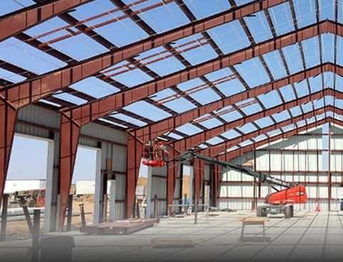
Extensions of design
QC Manager must ensure coordination between disciplines and activities
Examples of Extensions of Design:
  Pre-Engineered Metal Buildings
  Fire Alarm and Protection Systems
  Curtain Walls
Pg 18
Notes:
Ask: Are extensions of design normally found in a DB or a DBB type contract?
- DBB

Slide 68
Requests for information (RFI)
Effective RFI Process:
  Review of all applicable contract documents
  Coordinate with subcontractors/suppliers
  Clear and succinct problem statement
  Suggested solution
  Timeline to minimize costs and/or schedule impacts
Pg 18-19

Slide 69
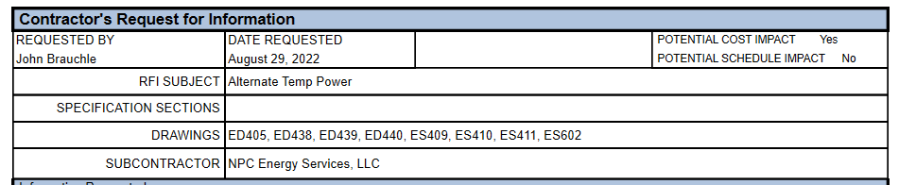
RFI Example

Slide 70

Why submit an rfi?
Class Exercise: Follow my instructions…
Customer: Wants “folded structure”
Designer: Provides instructions
Contractor: Reads instructions; gets to work
Is this what you wanted?
Notes:
Colored pieces of paper should have been placed at each student’s seat. Importance is to show how misunderstanding can happen easily even if the same direction is given. Did I misspeak or did they mishear?
Instructor should give purposefully vague but seemingly clear instructions. Give short answers to any questions the students ask about your instruction; repeat as necessary. Do not show them how your folding!
The purpose of the activity is for students to practice their listening and critical thinking skills as well as to reflect on how and why vague, one-sided communication is often limiting.
Step 1: Fold your paper in half.
Step 2: Tear off the bottom right corner of the paper.
Step 3: Fold the paper in half again.
Step 4: Tear off the upper right-hand corner.
Step 5: Fold the paper again.
Step 6: Tear off the lower left-hand corner.
3. Inform students that the goal is for everyone to produce identical pieces of paper by following the recorded instructions.
4. Share the pre-recorded instructions with students via your preferred educational tech platform/tool. (Consider Loom or Flipgrid)
5. Have students post an image of/share their work on the assigned online learning platform. (Consider Flipgrid or Padlet)
6. Once all students have shared and compared their work, then show your ‘official’ version of the paper pattern using the same platform or live for a synchronous discussion.
7. Lead students in the discussion.
8. Debrief the activity with the Discussion Follow-up.
Discussion
1. What happened during this activity?
2. What strategies did you use to do the task?
3. What similarities or differences did you notice about other students’ paper patterns?
4. How does your paper pattern compare to the teacher’s ‘official’ paper pattern?
5. If you were to do this task again, what might you do differently?
6. How did one-sided communication (i.e. students were unable to ask questions and get feedback) impact your ability to succeed with this task?
7. What additional strategies could speakers use to help listeners better understand instructions and tasks?
8. What communication strategies do you use in your school and daily life to help others to understand what you mean?
Discussion Follow-up
1. To even something as simple as folding paper can be interpreted in a hundred different ways.
2. What typically happens is that the people create many different shapes out of their papers, even though they all followed the same instructions.
3. We generally focus attention on what we want to say much more rather than on what our listeners want to or are able to hear.
4. We assume that if we do an expressive job of describing our mental image, the listeners will end up with the same images in their min

Slide 71

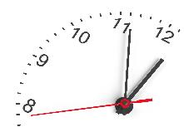
MODULE 2 CLASS work
Read Module 2
Answer Questions #1-7
Question #7 Group Exercise – RFI Review
  Each group given one RFI
  Write down responses for your given RFI
35 Minutes
Pg 20
Notes:
**** Instructor explain to class - Specs supersede plans, FAR 52.236-21

Slide 72
MODULE 2 – question #1
Question #1
Name three instances of KTR extensions of design?
Answer #1:
Concrete reinforcement drawings
Structural steel details
Fire alarm and protection systems

Slide 73
MODULE 2 – question #2
Question #2:
Name some possible areas that must be addressed during the construction coordination review of plans and specifications.
Answer #2:
Site conditions and restraints: Check for proper utility interface with existing facilities. Verify locations of utilities in the facility, waste disposal, site location, site survey control point, etc.
Proper allowance for maintenance space and access: The contractor shall prepare layout drawings of equipment to assure that adequate maintenance access has been provided.
Conflicts and discrepancies between plans and specifications.

Slide 74
MODULE 2 – question #3
Question #3:
What are the responsibilities of the QC Manager during the design phase of a design-build project and what must the Design Quality Control Plan include?
Answer #3:
The responsibilities of the QC Manager are to take an active role in the review and coordination of the design, to include, but not be limited to:
Constructability
Operability
Environmental
Review of all drawings and specifications
Coordination between different disciplines and trades to prevent any interference between different components
Coordination with suppliers, and
Selection of materials and equipment to assure utilities connectivity and physically fitting into provided spaces.

Slide 75
MODULE 2 – question #4
Question #4:
In a design-build contract, when should an RFI be used, when should a DVCR be used?
Answer #4:
A DVCR is used by the contractor to request clarification or ask questions regarding the approved design from the Designer of Record (DOR). If the DVCR identifies the need for information from the Government is needed, then an RFI is submitted to the Government.

Slide 76
MODULE 2 – question #5
Question #5:
What are the key elements of an effective RFI?
Answer #5:
Review of all applicable contract documents
Coordination with affected sub-contractors and suppliers
Clear and succinct problem statement
Suggested solution
Timeframe that a response is required in order to minimize cost and/or schedule impacts

Slide 77
MODULE 2 – question #6
Question #6
What are the key elements of an effective RFV?
Answer #5:
Navy Contracts only

Slide 78
MODULE 2 – question #7
Question #7
7. RFI Examples 1 – 4 (Make use of writing down team answers)
All groups – review example RFIs 1-4
Group 1 – discuss RFI-1
Group 2 – discuss RFI-2
Group 3 – discuss RFI-3
Group 4 – discuss RFI-4
Class Discussion

Slide 79
Quality Management Planning
Module 3
Notes:
Planning is essential to being PRO ACTIVE
the contractor’s QC Plan is a contract requirement
This module will dive into….
- Purpose and Components
- Review and Acceptance

Slide 80
Quality Management Planning – Purpose and Components
Sub-Module 3.1
Notes:
Planning is essential to being PRO ACTIVE

Slide 81
Objectives
Identify the Components of a Quality Assurance (QA) Plan
Define Quality Control (QC) Plan
Identify the components of the QC Plan
Pg 25

Slide 82
Contract duration timeline quality management activities
Design & Solicitation
Award
Construction Start
Construction
Construction Complete
Turnover
QC and QA Plans
Pre-Con
Draft Quality Control Plan
Punchout inspection
MUM
Pre-Final
Quality Control Plan
RMS Set-up / Submittal Register
Final Inspection
Quality Control Plan
Notes:
QC Plan must get you from the start to the end

Slide 83
quality management Plans
QC Plan
QA Plan
Prepared by QAR
Prepared by CQCSM
Outline the Quality Control procedures
Management tool to provide quality assurance
Notes:
*Show example QA Plan
The QA Plan ensures that all team members are following the same plan
achieves better coordination of the government’s QA activities.
contractor will be receiving consistent guidance
quality control and quality assurance must be coordinated and complement one another.
The components of a QA Plan are:
• Government staffing requirements.
• Functions of each QA team member.
• Government training requirements.
• Government pre-award activities.
• Definable Features of Work (DFOW) list.
• Government surveillance and testing activities.
The QC Plan: foundation upon which quality work is based.
outline of the planned quality control procedures and is vital to the quality control system.
the plan must be comprehensive, detailed, and logical
While experience and knowledge of the construction industry are necessary in developing a good QC Plan, the contractor must consider fully the specific contract requirements and special factors particular to a project as well.
Ask: Who has prepared a QC plan?
Ask: Who has prepared a QA plan?
Ask: Are these plans changed and updated as the project progresses?

Slide 84
quality control plan components
Organizational chart with lines of authority,
Names, qualifications, duties, responsibilities, and authorities
Appointment Letters
Submittals Control, verification and testing procedures
Testing
Tracking of Control Phase Inspections, control tests, and documentation
Tracking Deficiencies/Rework
Reporting procedures
List of definable features of work (DFOW)
Coordinate scheduled work with special inspection
Completion Inspection
(DB Only) Additional Requirements for Design Quality Control (DQC) Plan
*needs to be approved by Contracting Officer prior to start of work
Reference:
Section 01 45 04.00 29 Contractor Quality Control) 3.2 Quality Control Plan
Engineering Pamphlet EP-715-1-2 (A guide to effective Quality Control)
Pg 26-30
Notes:
Submit no later than 30 days after NTP.
needs to be approved by Contracting Officer prior to start of work
Ask: Where are the required components of the QC plan listed?
- 01 45 04.00 29 Contractor Quality Control
Ask: What is a DFOW (#9) , anyone?
- we will talk more about that on the next slide

Slide 85
Definable features of work (DFOW)
Task that is separate and distinct
  Separate QC requirements
  Trades, work crews unique
  Critical path activity
  Monitored by QC Specialist or Special Inspector
Each specification can be a DFOW
  Can be more than one DFOW per specification section
  Multiple specifications can apply to a DFOW
Pg 29

Slide 86
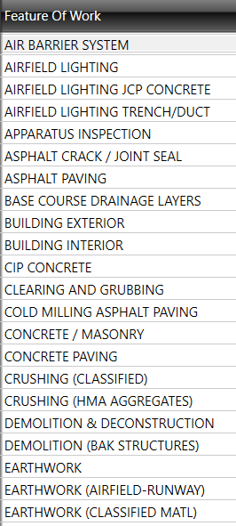
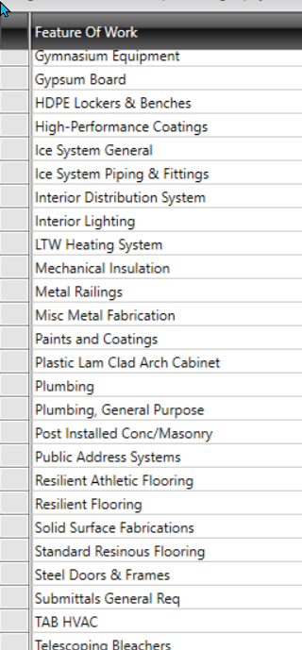
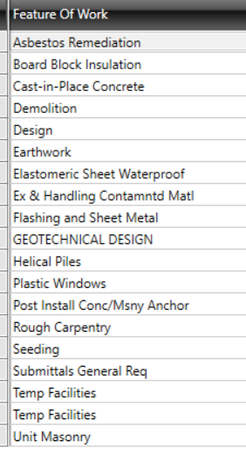
DFOW Examples
Notes:
Discuss: DFOWs. How many DFOWs are needed? Can you have too many DFOWS? What happens if you don’t have enough DFOWs?

Slide 87
Three phases of control
Preparatory
Performed prior to work on DFOW
Initial
Must be held at the beginning of physical work on DFOW
Follow-up
On-going series of inspections of work in progress
Review of applicable specifications & plans
Approved submittals
Materials check
Review of preceding work
Check of repetitive deficiencies
Documented on preparatory phase checklist
Review preparatory meeting notes
Check preliminary work
Verify adequacy of controls; establish level of workmanship
Resolve all differences
Discuss site safety requirements & the activity hazard analysis with all workers
Documented on Daily Reports
Continued throughout construction process
Documented on initial phase checklist
Pg 28
Notes:
Each DFOW will require the 3-phase control
The CQ plan must include procedures for performing 3-phase control
Pg 28 – When are these implemented?
More to come… In section 6.2, pg 53

Slide 88

Sub-module 3.1 – in class work
    Read Module 3.1
    Answer Questions #1-5
    20 Minutes
Pg 31

Slide 89
Sub-module 3.1 – question 1
      Question #1: Define the Quality Assurance Plan
      Answer #1: The QA Plan is a Government document used as a management tool at all levels of the organization with increasing specificity as it moves from the program to project level.

Slide 90
Sub-module 3.1 – question 2
      Question #2: Define a Quality Control Plan
      Answer #2: A QC Plan is a detailed outline of the contractor's planned QC procedures. It is the foundation upon which quality work is based.

Slide 91
Sub-module 3.1 – question 3
      Question #3: Name the components that must be addressed by the Quality Control Plan.
      Answer #3:
    Required components of the QC Plan are:
    Table of Contents,
    QC organization, including a chart showing lines of authority, QC staffing,
    names and qualifications of individual QC personnel, this includes subcontractors and supplier personnel assigned QC duties, and assignment of a single QC manager and QC manager alternate,
    duties, responsibilities and authorities of QC Personnel, to include delegated QC duties,
    outside organizations,
    appointment letters,
    a list of definable features of work,
    procedures for performing the three phases of control,
    submittal procedures and initial submittal register,
    testing laboratory information,
    testing plan and log to include procedures for giving advance notice to the
    Government for the conduct of tests,
    procedures for tracking construction deficiencies/rework items,
    procedures for completion inspection, and
    documentation procedures, to include completion turnover procedures.
    personnel matrix (NAVFAC contracts only)
Notes:
Refer to the contract for actual QC plan requirements… itll be your guide…

Slide 92
Sub-module 3.1 – question 4
      Question #4: Name the actions that must be accomplished relative to the CQC plan before construction can begin.
      Answer #4: The QC Plan must be received, reviewed, and formally accepted by the Contracting Officer or their representative before construction/work can begin.

Slide 93
Sub-module 3.1 – question 5
      Question #5: Name the phases of the "Three-Phase Control," and indicate when each is implemented.
      Answer #5:
  Preparatory Phase – this phase shall be performed prior to beginning work on each definable feature of work. Use the Preparatory Phase checklist when conducting this phase meeting. Safety is a consideration.
  Initial Phase – this phase must be accomplished at the beginning of a definable feature of work. Use the Initial Phase checklist when conducting this phase meeting. Safety is a consideration.
  Follow-up Phase – daily checks shall be performed to assure continuing compliance with contract requirements. Safety is a consideration.

Slide 94
Review and Acceptance
Sub-module 3.2
Notes:
Module 3.2 Review and Acceptance
• process used to review the contractor's Quality Control (QC)
• State the basic concepts which the government uses to accept or return a QC Plan.

Slide 95
Objectives
Describe the QC Plan review process.
  1) Verify contract compliance.
  2) Ensure plan is feasible.
Pg 32
Notes:
QC Plan must get you from the start to the end

Slide 96
Review process
Who Reviews the QC Plan
  Resident Engineer (RE)/Project Engineer (PE)/Construction Control
  Rep (Con Rep)/other onsite QA personnel
Two major steps
  Examine the QC Plan against the requirements of the specs
  Determination of the QC plan’s feasibility
Pg 32-33
Notes:
QC Plan must get you from the start to the end
Two Major Steps in the Review Process:
• Χομπλψ ωιτη χοντραχτ ρεθυιρεμεντσ?
• Determination of the QC Plan's feasibility. This requires the reviewers to
have a good working knowledge of contract requirements.

Slide 97
Minimum requirements
Does the plan provide adequate control of the DFOWs
Determine the qualifications for key personnel are met
Check to see that correct level of authority has been granted to the CQCSM
Clearly assigns individual control and test duties
Identify which individuals will be performing QC duties
Pg 32
Notes:
****EMPHASIS ON READING THE QC SPEC****
Assure Minimum Requirements Are Met:
Αdequate control of the DFOWs.
ΘΧ staffing and organization?
Check that the level of authority and responsibility delegated to the contractor's QC Manager is clearly defined.
clearly assigns individual control and test duties,
defines the capacity in which individuals will be working, and
indicates what tests will be used.
Determine that the plan addresses the procedures for processing submittals.
Check that the plan specifies which contractor (prime, subcontractor, offsite fabricator, or supplier) will be performing what portions of QC

Slide 98
Keep in mind
Approval is required for the QC Plan and the QC Manager
Plan can still be altered
Changes must be approved and accepted again
The Government can require changes
    Ex. Replacing QC manager!
Pg 32
Notes:
Ask: If you have written a QC plan and gotten it approved, what lessons can you share?
Review: What are the two major steps in the review process?
• Χομπλψ ωιτη χοντραχτ ρεθυιρεμεντσ?
• Determination of the QC Plan's feasibility. This requires the reviewers to
have a good working knowledge of contract requirements.

Slide 99

Sub-module 3.2 – in class work
    Read: Module 3.2
    Read & Complete: QC Plan Group Exercise in Appendix B
    20 Minutes
Pg 34

Slide 100
Sub-module 3.2 – QC Plan Group Exercise
    As a group, review Keyes plan and identify how if could be improved to meet the contract requirements.
      a. Letters of Authority and Qualifications of Personnel.
      b. No organization chart of the lines of authority and CQC Personnel.
      c. Although Mr. McCray is appointed to the Quality Control Position, it is not clear whether he is the Quality Control System Manager, or a member of the Quality Control staff.
      d. Spec paragraph 3.3.2.2 requires resumes, duties, etc., of each person assigned a QC function.
      e. The Quality Control support team consisting of the superintendent and Keyes' Project
      f. Managers are designated, as CQC but resumes, etc., are not included.
      g. Letter of authority did not state he had authority to stop deficient work.

Slide 101
Sub-module 3.2 – QC Plan Group Exercise continued
      h. 2.0-C (Policy) should state that notification of deficiencies begins with the foreman, then superintendent, and then Project Manager. This should not occur because all people should know that the CQC has the authority to reject non-compliant work.
      i. (Quality Control Representative) yet another term without contractual meaning further confusing the CQC staff. We still do not know who the CQC system manager is.
      j. 3.2 (Contractor's other personnel) The Government should review and approve whether the contractor's superintendent is qualified or has time to function as CQC staff.
      k. 4.1-A (Preparatory Phase) Contract specifications require a review of contract plans.
      l. We find no evidence of Government approval of CQC test lab.
      m. The Daily report has no space for "Visitors Today".
      n. No list of QC tests is provided.

Slide 102
Post-Award / Pre-construction Conferences and Mutual Understanding Meeting (Coordination Meeting)
Module 4
Notes:
Module 4 – Post award meetings
purpose of the meetings
when do the meetings occur and and who should attend

Slide 103
Objectives
State the Objectives of the Post-Award Orientation Conference (DB)
State the objective of the Pre-Construction Conference (DB and DBB)
State the purposes of the Coordination Meeting or the Mutual Understanding Meeting (DB and DBB)
Pg 35
Notes:
Ask: Show of hands, who has attended one or more of these meetings?

Slide 104
Contract duration timeline
Module 4 - major qc ACTIVITIES
Design & Solicitation
Award
Construction Start
Construction
Construction Complete
Turnover
Pre-Construction Conference (DB)
Mutual Understanding Meeting (DB or DBB)
Post-Award Conference (DB)
Pre-Construction Conference (DBB)

Slide 105
PRE-Construction Conference
PRE-CONSTRUCTION CONFERENCE agenda Appendix c
Purpose - Establish ground rules for administering the contract
Hosted by Government – Minutes by COR / PE
Attended by all Stakeholders
Review Drawings, Scope of Work (SOW), Contract conditions etc.
Contract Clauses (e.g., Accident Prevention, Personnel, Procedures)
Discuss Partnering
For DB normally occurs after the Post Award Orientation Conference due to time it takes to complete the design
Pg 36 & 130
Notes:
Ask: Have class turn to Appendix C in the student study guide and briefly scan the topics.

Slide 106
POST Award Conference
Post award agenda
Purpose – Establish the ground rules for administering the design portion
Hosted by Government – Minutes by COR/ PE
DB contractor, major subcontractors and Design Team required to attend
Attended by all Government stakeholders
Introduction of Contract Persons and their authorities
Project Progress Processes expectations
Contract Clauses
Discuss or Hold Initial Design Meeting
Discuss Partnering

Slide 107
MUTUAL Understanding
Mutual understanding agenda Appendix d
Purpose – Establish a mutual understanding of the CQC system details
Hosted by Government – Minutes by QA signed by all participants
Often called Coordination Meeting
Participants - all personnel directly involved in Quality Control (GOV, KTR, Subs) (if involved in quality control)
Review QC Plan (i.e. Concept, DFOW subject to 3-Phase System…)
Contractor Quality Control Procedures (e.g. QC role, QC Procedures)
Establish a good relationship and mutual understanding of the roles
Subsequent conferences may be required
Pg 131
Notes:
Mutual Understanding Meeting by some specs called Coordination Meeting
Ask: Have class turn to Appendix D in the student study guide and briefly scan the topics.
Ask: Why might it be necessary to hold a second or third MUM?
- QC system is not working effectively
- Change of contractor QC personnel

Slide 108

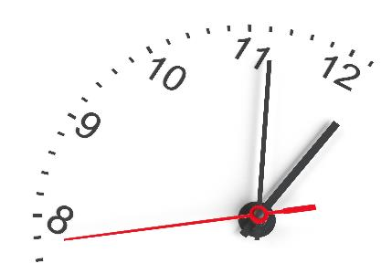
MODULE 4 CLASS work
Read Module 4
Answer Questions #1-6
15 Minutes
Pg 38

Slide 109
MODULE 4 – question #1
Question #1
What is the objective of the Post-Award Orientation Conference/Pre-Construction Conference?
Answer #1:
The objective of the Post-award Orientation Conference/Preconstruction Conference is the review the contract clauses to include accident prevention, administrative requirements, personnel requirements, and procedural matters.

Slide 110
MODULE 4 – question #2
Question #2
Why is the Post-Award Orientation Conference/Pre-Construction Conference Important?
Answer #2:
The Post-award Orientation Conference/Preconstruction Conference is important because it establishes the ground rules for administering the contract.

Slide 111
MODULE 4 – question #3
Question #3
Who schedules, convenes, and conducts the Coordination Meeting or the Mutual Understanding Meeting?
Answer #3:
The Government

Slide 112
MODULE 4 – question #4
Question #4
What are the primary purposes of the Coordination and Mutual Understanding Meeting?
Answer #4:
There are three primary purposes of the Coordination and Mutual Understanding Meeting:
to achieve a mutual understanding with the contractor of his role in quality control,
to review the QC Plan with the contractor, and
to establish a good working relationship between the Government and the contractor.

Slide 113
MODULE 4 – question #5
Question #5
Who attends the Coordination and Mutual Understanding Meeting?
Answer #5:
Attendance to the Coordination and Mutual Understanding Meeting should include all Government, contractor, and subcontractor personnel who will be involved in construction quality management.

Slide 114

MODULE 4 – question #6
Question #6:
What are the most important topics of the Coordination Meeting or the Mutual Understanding Meeting and how should the CQC Manager prepare for this meeting?
Class Discussion

Slide 115
Submittals
Module 5
Notes:
Things to know about submittals……
Regulate materials, plans, shop drawings, qualifications, permits, etc.
Demonstrate contract compliance
needed before Preparatory Phase

Slide 116
Objectives
Describe Government responsibilities for submittal review and/or approval.
Describe contractor responsibilities for the scheduling and control of submittals.
Understand that the Submittal Register is a tool to regulate the timely flow of materials, or equipment, coming to the job site.
List the information the contractor must furnish on the submittal control document (ENG Form 4288-R - Submittal Register).
List the information the contractor must furnish on the transmittal form (ENG Form 4025-R)
Pg 39

Slide 117
Purpose of submittals
Regulate materials, plans, shop drawings, qualifications, permits, etc.
Demonstrate contract compliance
Submittals needed before Preparatory Phase
All required submittals must be provided in time to allow for the review, approval, procurement, delivery, and performance of the PREPARATORY PHASE CONTROL.
Submittals are indispensable in assuring and controlling construction quality and must be given the attention required.
Pg 39

Slide 118
Submittal process
Submittal Register, ENG Form 4288-R, identifies required submittals and the required approval authority for each.
Approval authorities will vary depending upon type of contract (DB/DBB)
Submittal definitions and procedures
  FAR 52.236-21 SPECIFICATIONS AND DRAWINGS FOR CONSTRUCTION
  01 33 00 SUBMITTAL PROCEDURES
  01 33 16.00 10 DESIGN DATA (DESIGN AFTER AWARD)
Pg 39

Slide 119
Submittal classifications
Government Approved (GA) | For Information Only (FIO)
extensions of design, | catalog cuts,
critical materials, | shop drawings that are not extension of designs,
variations, | shop drawings that do not contain variations
government required plans, | material samples for non-critical materials; i.e., sheet metal accessories, or equipment such as small motors
Schedules,
O&M Manuals,
As-Built Drawings,
equipment whose compatibility with the entire system must be checked.
30-day review period (will vary, see contract) | Government will review 10% of FIO
Pg 40

Slide 120
Ktr Submittals responsibilities
Complete Submittal Register
CQCSM will review all submittals for contract compliance
Plan for review times
Submittals must be on the agenda for the preparatory control phase.
Submittals must be scheduled to match the activity
Submittals must be approved before holding the preparatory control phase
Pg 41
Notes:
The scheduling function of the submittal process has been solely designed for the contractor procurement scheduling – Example (experience): Product in one week on site, gov’t review: Product incorrect …
Ask: Where is the submittal register found in the contract?
- 01 33 00 Submittal Procedures
Ask: Why is the contractor responsible for completing the submittal register in a DBB contract?
Ask: In a DB contract who must also review submittals, CQCSM and ????? ?
- Designer of Record

Slide 121
Gov’t Submittals responsibilities
Prepare a list of required submittals on a draft submittal register
  01 33 00 Submittal Procedures
Perform cursory checks on FIO submittals
Gov QA emphasis will focus on ensuring contractor QC system is effective
Review and approve GA submittals
For DB contracts gov will review for conformance
Pg 42-23
Notes:
Ask: In a DB contract, gov will review for conformance. Conformance with what?
contract which includes the accepted proposal
Accepted design documents
Discuss: What are some indication that the QC system is not working effectively based solely upon the submittal process?
- cursory checks of FIO conformance find non-compliant parts
- material is arriving onsite without an approved submittal
- multiple requests for expedited approvals
- Buy America Act non-compliance

Slide 122
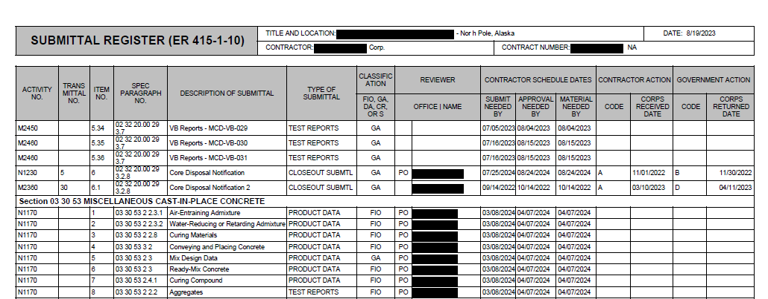
Submittal register

Slide 123
variations
Variations require Contracting Officer approval and a written documentation package:
  Benefit to the Government.
  Meet the intent of the design
  If a variation is not identified on ENG Form 4025-R, the Gov may rescind inadvertent approval.
  If approved, contract modification will be required
The variation approval process for DB contracts includes:
  DOR approval
  Government conformance review and approval
  Design, material and equipment submittals prior to or after Government acceptance of the design
Reference:
FAR 52.236-21 Specifications and Drawings for Construction
Section 01 33 00 (Submittal Procedures)
Engineering Form ENG 4288 – Submittal Register
Engineering Form ENG 4025 - Transmittal
Specific requirements in each contract section
Pg 42
Notes:
Written requests for variation
documentation of the nature and features of the variation
why the variation is desirable and beneficial to the Government.
Include the DOR's written analysis (for D-B contracts) and approval.
If lower cost is a benefit, also include an estimate of the cost savings.

Slide 124
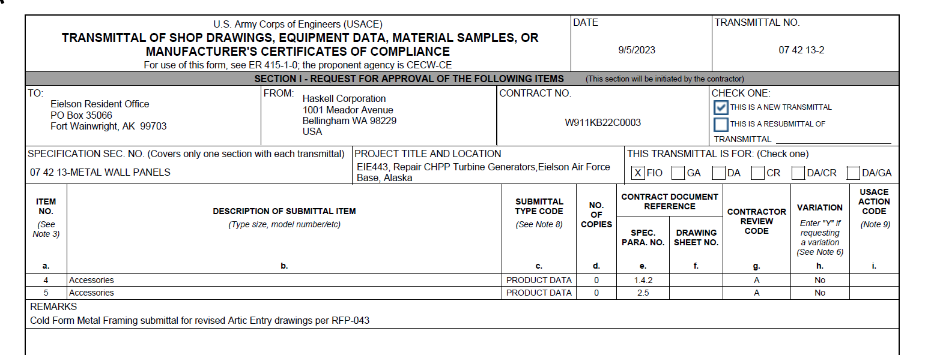
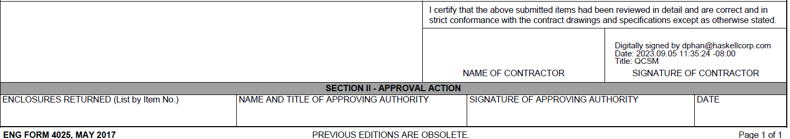
Example eng form 4025
*If a variation, Column (H) must be answered.
Gov action code
Ktr
action code
**Signature certification statement:
I certify that the above submitted items had been reviewed in detail and are correct and in strict conformance with the contract drawings and specifications except as otherwise stated.
Use to clarify
Notes:
Use REMARKS to communicate and clarify. If this is a variation, then add a short explanation about the variation.
Column H – Yes, if a variation
Submittal Action Codes (columns g and i)
- CQCSM will assign in column g of Section 1
- Gov will assign in column i of Section 1
Discuss: Certification statement puts a lot of responsibility on the CQCSM and if there are problems later with the item it may cause the gov to question the effectiveness of the entire QC system.
Ask: Students to turn to page 39-40 for Submittal Classifications for DB

Slide 125
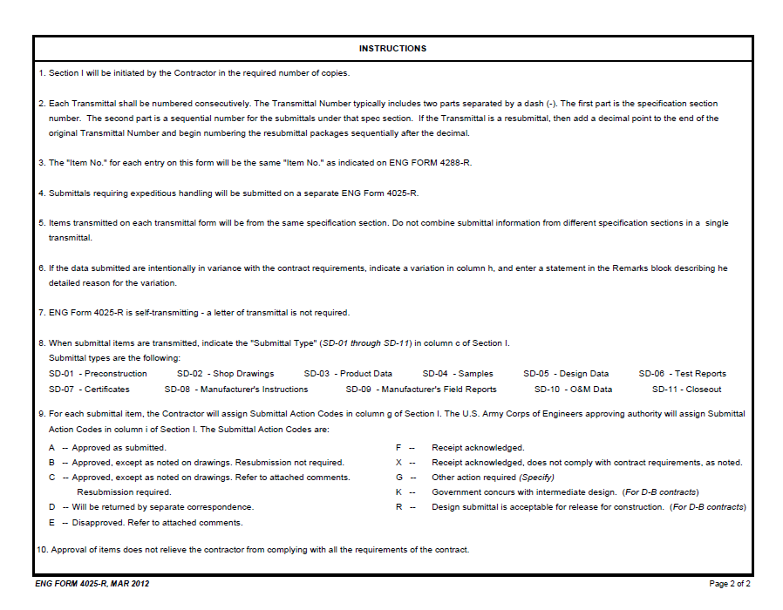
Back of eng form 4025
Submittal Action Codes:
A --- Approved as submitted
B --- Approved, except as noted on drawings
C --- Approved, resubmission required
D --- Returned by correspondence
E --- Disapproved
F --- Receipt acknowledged
X --- Receipt acknowledged, no comply
G --- Other (Specify)
K --- Government concurs with Interim Design
R --- Acceptable for Release for Construction
Notes:
Submittal Action Codes
- CQCSM will assign in column g of Section 1
- Gov will assign in column i of Section 1

Slide 126

MODULE 5 CLASS work
Read Module 5
Answer Questions #1-5
20 Minutes
Pg 45

Slide 127
MODULE 5 – question #1
Question #1:
What is the purpose of submittals?
Answer #1:
Regulate the timely flow of materials to be incorporated into work
Provided in time to allow for review, approval, procurement, delivery, and performance of the preparatory phase of the Three Phases of Control
Submittals are indispensable in assuring and controlling construction quality and must be given the attention required

Slide 128
MODULE 5 – question #2
Question #2:
What is the process the contractor must use to request a variation?
Answer #2:
Variations must be noted on ENG Form 4025 and fully described, identified, and justified in the transmittal package.

Slide 129
MODULE 5 – question #3
Question #3:
What are the contractor’s submittal responsibilities?
Answer #3:
Integrate the submittal process into his QC Plan
Delegate submittal responsibilities to the proper individuals on his staff
Government considers the handling of submittals to be important
Ensure that all submittals are in full compliance with the contract
Assure that work is not permitted to begin without properly approved submittals
Notes:
DBB - Review the Gov prepared Submittal Register and add any needed additional submittals,
DB - Review the Gov prepared Submittal Register and add any needed additional submittals, note that the DOR will need to identify the technical submittals.
DBB/DB
- check the submittal schedule requirements against the NAS,
- maintain and adjust dates on the register to ensure the document reflects current schedule information,
- ensure that all variations are fully described, identified, and justified in the transmittal package,

Slide 130
MODULE 5 – question #4
Question #4:
What are the Government’s submittal responsibilities?
Answer #4:
Prepare a list of submittals (on ENG Form 4288) required for each contract
Review a minimum of 10% of ‘For Information Only submittals’ (FIO)
Review and approve submittals that require Government Approved (GA)
Enforce submittal requirements

Slide 131
MODULE 5 – question #5
Question #5:
What information must the contractor provide in his submittal control document (ENG Form 4288 – Submittal Register)?
Answer #5:
the item number
the contractor schedule dates
the contractor action
NAS Activity Code, when applicable

Slide 132
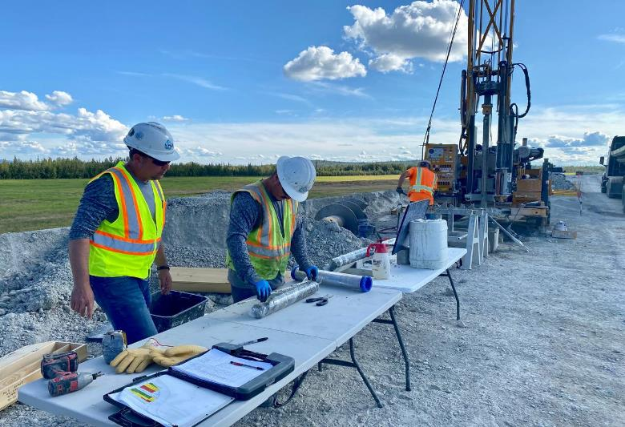
Quality Management for Construction Projects
Module 6

Slide 133
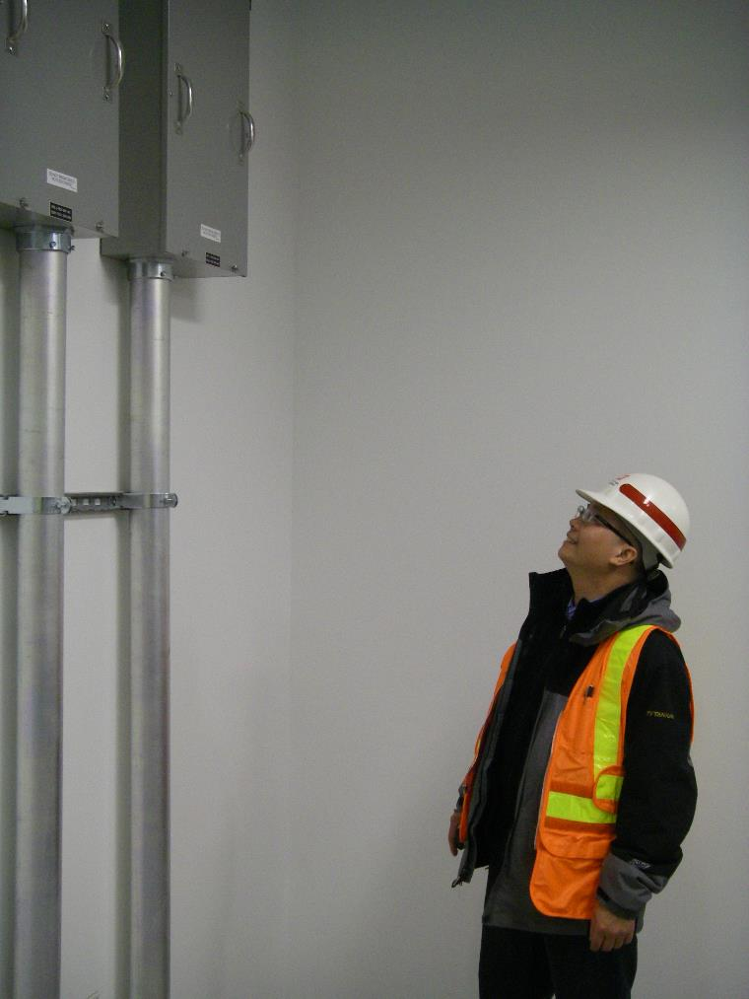
Introduction
Sub-module 6.1

Slide 134
Objectives
  Define the function and importance of Construction Quality Assurance
  Define the function and importance of Contractor Quality Control
      Design-bid-build contracts
      Design-build contracts
  Understand how QA & QC work together to achieve overall Quality Management
Pg 50

Slide 135
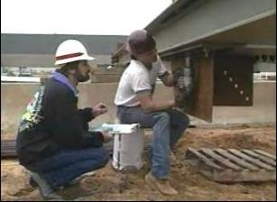
Construction quality management
Construction Quality Management depends on two things to make it function:
    Government Quality Assurance
    Contractor Quality Control
Quality Control + Quality Assurance = Quality Management
Notes:
The QC system builds quality into the product, while the QA system verifies contract compliance along the way. Together they help to ensure the overall quality of the product, which is what construction quality management is all about.
The Design QC plan shall be managed by Design QC Manager who has verifiable engineering or architectural design experience or as a registered engineer or architect.
This sub module will focus on the function of each and their importance throughout the construction process for achieving proper quality management
Quality Assurance
- examine QC methods used to determine they are effective
- If excessive deficiencies occur, QA personnel may require that the necessary changes are incorporated in the QC plan.
- assist the contractor to understand and implement the contract requirements.
- examine ongoing and completed work, as well as review QC documentation to assure adequacy.
Quality Control
- DBB/DB - PLAN to manage and control the activities of all those involved in the construction process to ensure compliance with the contract requirements.
- DB must include a Design QC plan

Slide 136
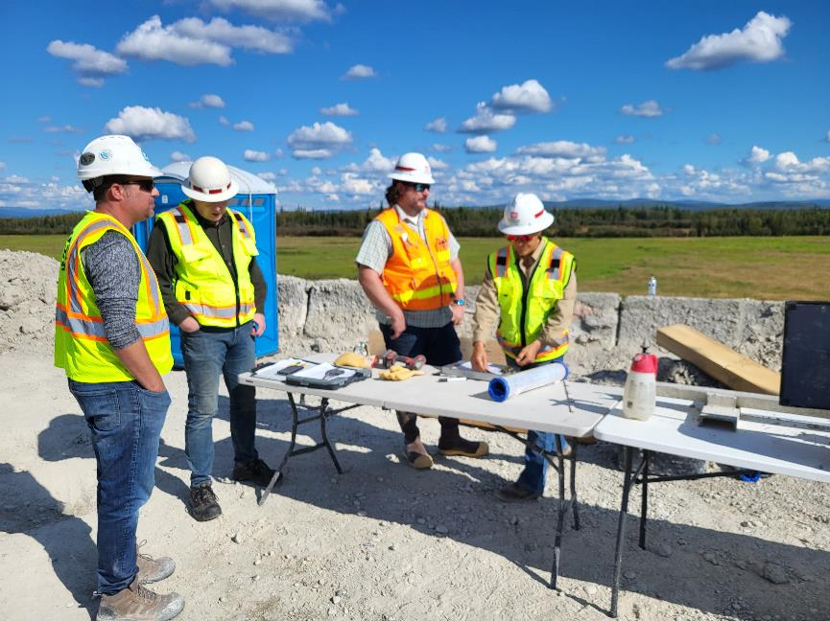
quality assurance
Primary Function – obtain completed construction that meets all contract requirements
QA personnel “assure” that completed construction meets all contract requirements
Examine QC methods and ensure they are adjusted if necessary
Assist contractor in understanding and implementing the contract requirements
Review QC documentation
Quality Control + Quality Assurance = Quality Management
Notes:
Discussion: From the contractor perspective, what techniques and practices demonstrated by the QAR have been most helpful to the Quality Management process?
Possible answers….
- communication
- relationships
- partnering
- good documentation

Slide 137
Quality Control
Primary Function – execute a realistic plan to ensure standards of quality are met
Control is the power to influence or direct people's behavior or the course of events.
Produce quality specified
Develop and maintain effective QC system
Perform all control activities and tests
Document all QC activities
QC Plan
Design QC Plan
Construction QC Plan
Quality Control + Quality Assurance = Quality Management
Notes:
Discussion: From the government perspective, what techniques and practices demonstrated by the CQCSM have been most helpful to the Quality Management process?.
Possible answers….
- communication
- relationships
- partnering
- good documentation

Slide 138
Sub-module 6.1 - class work
Read Sub-Module 6.1
Answer Questions # 1-4
10 Minutes
Pg 52

Slide 139
Sub-module 6.1 - Question 1
Question #1
What is the primary function of QA?
Answer #1
The primary function of QA is to obtain completed construction that meets all contract requirements.

Slide 140
Sub-module 6.1 - Question 2
Question #2:
What is the role of QA personnel?
Answer #2:
The role is to assure that the CQC system is functioning properly.

Slide 141
Sub-module 6.1 - Question 3
Question #3:
What is the primary function of CQC?
Answer #3:
The successful execution of a realistic plan to ensure that the required standards of quality construction will be met.

Slide 142
Sub-module 6.1 – Question 4
Question #4:
What are the roles of QC personnel?
Answer #4:
  Produce the quality specified in the plans and specifications, and for design-build contracts in the Request for Proposal, as well as the contractor's accepted proposal
  Develop and maintain an effective CQC system
  Perform all control activities and tests
  Prepare acceptable documentation of CQC activities

Slide 143
Sub-module 6.1 - Question 5
Question #5: For design-build contracts, what additional requirements must be included in the QC plan?
Answer #5:
Provide and maintain a Design Quality Control Plan as part of the overall QC Plan
A technically competent, independent reviewer specifically named in the plan must perform review of all documents
Management of the Design QC Plan shall be by a Design QC Manager who has verifiable engineering or architectural design experience or is a registered engineer or architect
The QC Manager performs supervision of the Design QC Manager.

Slide 144
Three-Phase Control System
Sub-module 6.2

Slide 145
Objectives
Define the purpose of control of onsite construction through the Three-Phase Control System
List the responsibilities of QC personnel regarding the Three-Phase Control System
Pg 53
Notes:
The foundation of Construction Quality Management is the Three Phase Control System – it requires the contractor to plan.
Quality Control personnel are responsible for the following:
-Developing, scheduling and implementing procedures for tracking control phase meetings for definable features of work in the QC plan.
-Notify all appropriate personnel of time date and agenda.
-Conducting meetings, both preparatory and initial.
-Implement safety considerations and analysis.
-Documenting actual discussions and providing minutes to attendees.
-Monitoring work in place through the follow up phase.
-And conducting additional control phase meetings as needed.
The Three phases of control are- Preparatory, Initial and Follow-up.
Preparatory Phase - performed prior to work beginning on a definable feature of work. Meeting conducted by CQCSM and attended by Super, foreman. Minutes recorded by CQCSM and attached to Daily QC report.
- review applicable specifications, references, and plans,
- check to assure that all materials / equipment have been tested, submitted and approved,
- check to assure adequate control inspections and testing is planned.
- Activity Hazard Analysis must be reviewed
- Procedures discussed for conducting the work including the review of repetitive deficiencies.
Initial Phase - held at the beginning of physical work on a definable feature of work and requires notification to gov (24 hours). Minutes recorded by CQCSM and attached to Daily QC report.
- Review of minutes from Preparatory
- get the work off to a good start
- ensure that the procedures discussed at the Preparatory meeting are being implemented.
- check preliminary work
- verify adequacy of controls to ensure full contract compliance;
- establish the level of workmanship required and resolve all differences .
- Site safety and the activity hazard analysis are discussed with all workers.
Follow-up phase - a series of ongoing inspections of the work in progress. Must be noted in QC Daily Report.
- to make sure the work is meeting the quality standards established in the preparatory and initial phases.
- these inspections must continue throughout the construction process until the work has been completed on a definable feature of work.
The Three-Phase Control System helps to make everyone's job easier, by defining the standards of quality, before the work has begun. It's important for quality control personnel to remember that their job is not just to detect problems, but also prevent them. Three-Phase Control System is a tool that allows them to do just that.

Slide 146
Contract duration timeline major qc ACTIVITIES
Design & Solicitation
Award
Construction Start
Construction
Construction Complete
Turnover
Reports & Submittals
Follow-up Phase Control DFOW #1
Initial Phase Control DFOW #1
Preparatory Phase Control DFOW #1
Quality Control Plan & other plans (e.g. Testing Plan)
Notes:
That’s why it’s a full-time job!

Slide 147
Definable feature of work
For each Definable Feature of Work …
Develop, schedule & implement procedures for the tracking 3-Phases
Schedule & Plan Ahead! (Submittals, Invoicing etc.)
Notify appropriate personnel (time, date, agenda) for Prep. & Initial invitation to gov’t is required, even if gov’t not intend attend!
Safety & AHA (Activity Hazard Analysis for each DFOW
Document discussions & meeting minutes
Monitor work in place (Follow-ups) – also relevant for invoicing
Conduct additional phase meetings as required
Intention: Detect problems but also prevent them!

Slide 148
Three phases of control
Preparatory
Performed prior to work on DFOW
Initial
Must be held at the beginning of physical work on DFOW
Follow-up
On-going series of inspections of work in progress
Review of applicable specifications & plans
Approved submittals
Materials check
Review of preceding work
Check of repetitive deficiencies
Documented on preparatory phase checklist
Review preparatory meeting notes
Check preliminary work
Verify adequacy of controls; establish level of workmanship
Resolve all differences
Discuss site safety requirements & the activity hazard analysis with all workers
Documented on Daily Reports
Continued throughout construction process
Documented on initial phase checklist
Pg 53-55
Notes:
The foundation of Construction Quality Management is the Three Phase Control System – it requires the contractor to plan.
Preparatory Phase - performed prior to work beginning on a definable feature of work. Meeting conducted by CQCSM and attended by Super, foreman. Minutes recorded by CQCSM and attached to Daily QC report.
- review applicable specifications, references, and plans,
- check to assure that all materials / equipment have been tested, submitted and approved,
- check to assure adequate control inspections and testing is planned.
- Activity Hazard Analysis must be reviewed
- Procedures discussed for conducting the work including the review of repetitive deficiencies.
Initial Phase - held at the beginning of physical work on a definable feature of work and requires notification to gov (24 hours). Minutes recorded by CQCSM and attached to Daily QC report.
- Review of minutes from Preparatory
- get the work off to a good start
- ensure that the procedures discussed at the Preparatory meeting are being implemented.
- check preliminary work
- verify adequacy of controls to ensure full contract compliance;
- establish the level of workmanship required and resolve all differences .
- Site safety and the activity hazard analysis are discussed with all workers.
Follow-up phase - a series of ongoing inspections of the work in progress. Must be noted in QC Daily Report.
- to make sure the work is meeting the quality standards established in the preparatory and initial phases.
- these inspections must continue throughout the construction process until the work has been completed on a definable feature of work.
The Three-Phase Control System helps to make everyone's job easier, by defining the standards of quality, before the work has begun. It's important for quality control personnel to remember that their job is not just to detect problems, but also prevent them. Three-Phase Control System is a tool that allows them to do just that.

Slide 149
Qc personnel responsibilities
Developing, scheduling, and implementing procedures for tracking control phase meetings for DFOW in the QC Plan
Notify all appropriate personnel of time date and agenda
Conduct preparatory and initial phase controls and other meetings when necessary
Implement safety considerations and analysis
Documenting actual discussions and providing minutes to attendees
Monitoring work in place through the follow up phase

Slide 150
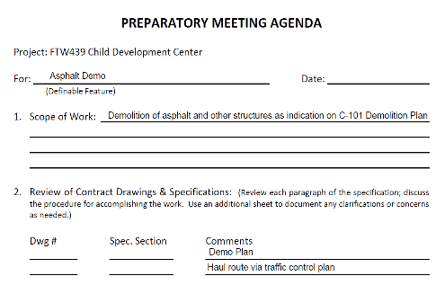
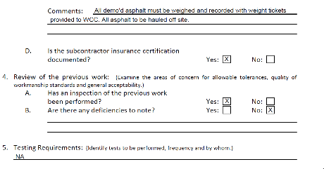
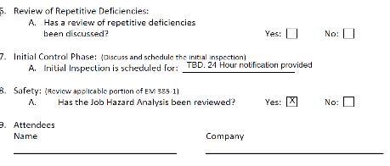
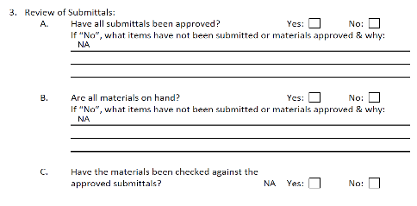

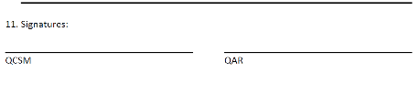
Preparatory Agenda
Notes:
Use this as a template to create your own Preparatory Agenda.

Slide 151
Sub-module 6.2 - class work
Individual Work
  15 Minutes
  Read Module 6.2
  Answer Questions # 1, 2, & 5
Group Work
  15 Minutes
  Answer #4
      Group 1 4.a, 4.b
      Group 2 4.c, 4.d
      Group 3 4.e, 4.f
      Group 4 4.a, 4.e
Pg 57

Slide 152
Submodule 6.2 - Question 1
Question #1:
What is the primary purpose of the three-phase control system?
Answer #1:
The primary purpose of the three-phase control system is to require the contractor to plan and schedule the work to ensure that they are prepared to start each new feature of work.

Slide 153
Submodule 6.2 - Question 2
Question #2: Regarding the three-phase process, what are the responsibilities of the quality control personnel?
Answer #2:
  Develop, schedule, and implement procedures for tracking control phase meetings for definable features of work in the QC Plan
  Notify appropriate personnel of time, date, and agenda
  Conduct meetings (Preparatory and Initial)
  Safety considerations and Activity Hazard Analyses (AHAs)
  Document actual discussions and provide minutes to attendees
  Monitor work in place through follow-up phase
  Conduct additional control phase meetings, as needed

Slide 154
Sub-module 6.2 - Question 4a
    Question #4a:
    Wall tile installation in 325 bathrooms of a large hospital is complete. The 4”
    square ceramic tiling is not lying uniformly flat (and outside of tolerances) on
    the grout bed and the owner is concerned about the obvious shadows that are
    evident between tiles under certain lighting conditions.

Slide 155
Sub-module 6.2 - Question 4b
    Question 4b:
    Floor system consisting of 2.5” concrete on metal deck on metal joists on steel
    beams/girders experienced excessive movement during concrete
    placement. Floating of low spots and grinding of high spots was required.

Slide 156
Sub-module 6.2 - Question 4c
    Question #4c:
    275 electrical outlets 10A electrical outlets were installed. 15A outlets are
    required furthermore some of the outlets test with reverse polarity.

Slide 157
Sub-module 6.2 - Question 4d
    Question #4d:
    Rough-in electrical is proceeding on schedule but ten days into the installation it
    is discovered that the outlet boxes and conduits were made in China.

Slide 158
Submodule 6.2 - Question 4E
    Question 4e:
    Initial phase meeting for interior painting was held; however, the government did not
    attend, and the initial phase checklist was not completed nor was it attached or
    referenced in the QC daily report.

Slide 159
Submodule 6.2 - Question 4F
    Question 4f:
    Mechanical plumbing rough-in has been proceeding for 6 weeks. Preparatory and
    initial control phases were held and properly documented. The QC is walking thru
    the work area most days but neglects to document any follow-up inspections in the
    QC daily report. Yesterday it was discovered that the wrong schedule pipe was being
    installed.

Slide 160
Sub-module 6.2 - Question 5
    Question #5: Identify the appropriate phase (preparatory, initial, or follow-up) of construction for the ten activities listed below by placing a P, I, and/or F next to it.
    Answer:
      Checking temperature of in-place concrete
      Observing erection of a sample panel of CMU
      Verifying all submittals have been submitted and approved
      Development of an excavation plan
      Start up of the painting contractor
      Gradation check of stone at quarry
      Calibration check of density meter before bringing to site
      Daily check of workers’ hard hats
      Review of controls pertaining to a feature of work
      Replacement of a lift of concrete

Slide 161
Documentation
Sub-module 6.3
Notes:
If it is not documented, did it happen?
Contemporary documentation carries more weight if legal actions arise.
Documentation is a contract requirement and is not optional. The government is paying for documentation as part of the contract price.

Slide 162
Objectives
Explain purpose of CQC report
List the components CQC report
Explain the purpose Gov’t QA report
Discuss review and use of Quality Management Reports
Correction to SSG: Page 64. Change “Appendix J” to read “Appendix E”
Pg 62

Slide 163
Quality records management keeping
The importance of comprehensive record-keeping and information exchange cannot be overemphasized
Documentation serves as a management and communications tool
Provides written record of meetings, activities and problems that occur during contract duration
Most common forms of documentation are the contractors QC report and the government’s QA report
Contemporaneous documentation carries the most weight in a legal action
Pg 62

Slide 164
Cqc report
The contract specifications require the contractor to submit QC reports daily
Should be submitted at a specified time every day
Report should contain information on all QC activities that have taken place that day
During shutdown periods, 1 report required every 7 days
Pg 63

Slide 165
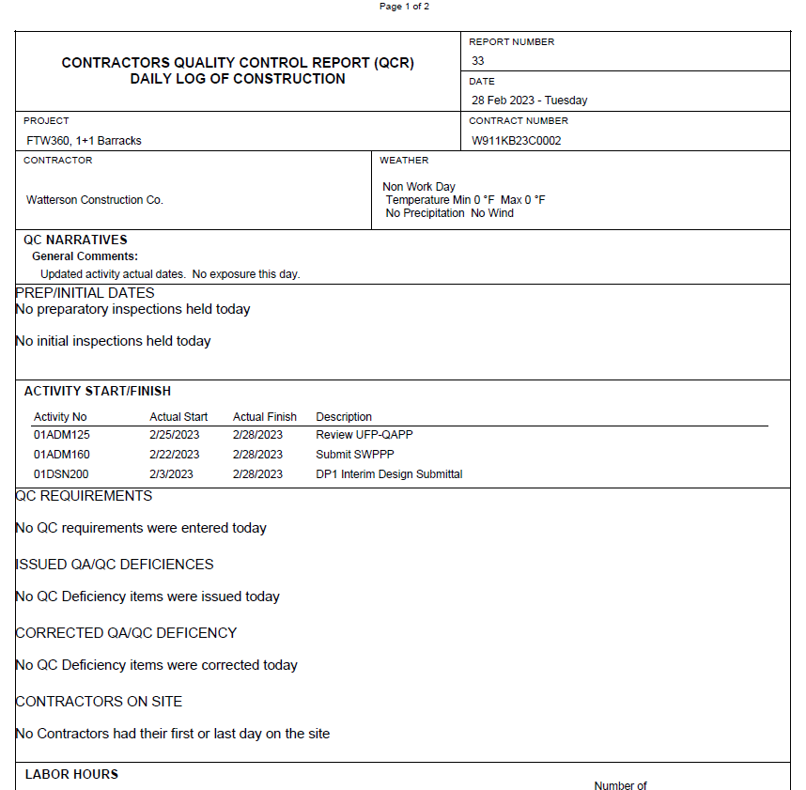
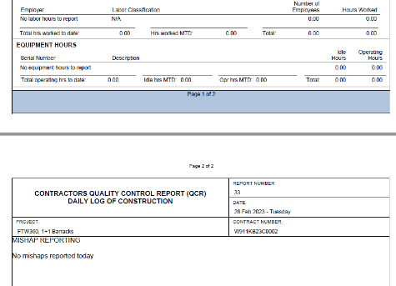
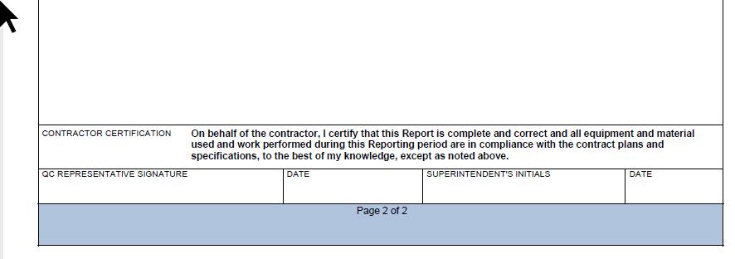
Qc report example
Notes:
The Government does not require a specific format for the QC report (However, RMS template is a good way to go)
Regardless of the form or format used, it must include all the information called for in section 01 45 00.00 10 Contractor Quality Control.
Ask: Have students turn to SSG page 62 and 63 for a summary of required elements.
Ask: Have a student read aloud page 63 paragraph 3 and 4
The QC reports must present an accurate and complete picture of QC activities. QC reports should not concentrate only on work items that have been completed,
but also must provide evidence of control activities. They should be precise, factual, legible, as objective as possible, and emphasize QC actions.
QA personnel evaluate QC reports as they are received. If statements are discovered in the report that are contrary to QA personnel’s knowledge of the
work, action will be taken to resolve the differences. The contractor may be asked to resubmit an incomplete or incorrect report with corrections.

Slide 166
Government qa report
Prepared for each visit day by the on-site QA personnel
Government’s record of project related events including QA testing.
Not intended to duplicate any information contained in the QC report
Notes:
Ask: Is there a QA report for every day? No, only for each visit day.
Ask: Does the contractor get to see the QA report? No.

Slide 167
Communication & documentation
Minutes of all relevant meetings attached to the QC – report
QC - Report will be reviewed for completeness, accuracy and consistency.
Adverse weather days – 50% of work on critical path is obstructed
Near misses and mishaps* – reported on Form 3394.
Deficiency tracking: Found by QA or QC, corrected & confirmed
A QC report is required for every day (even for non-working days) and (if not agreed differently) must be issued to the gov’t daily.
* March 2024 new EM385-1-1

Slide 168
Site visitors
Record on CQC daily report
Name, title, representing, time on site
Findings and outcome
Deficiency tracking list
Communications on site

Slide 169
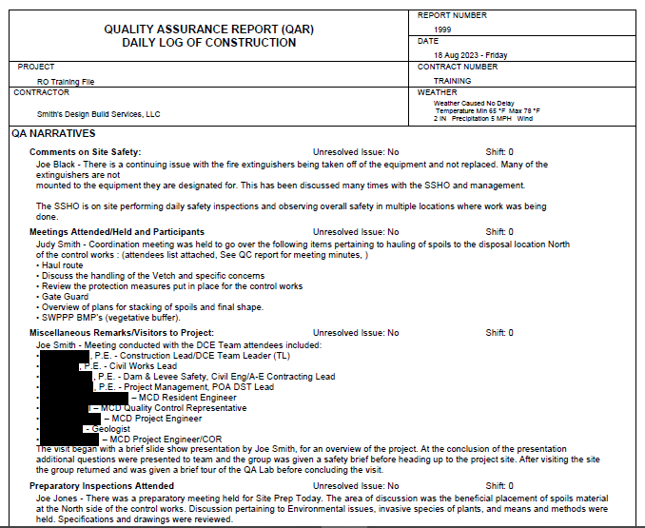
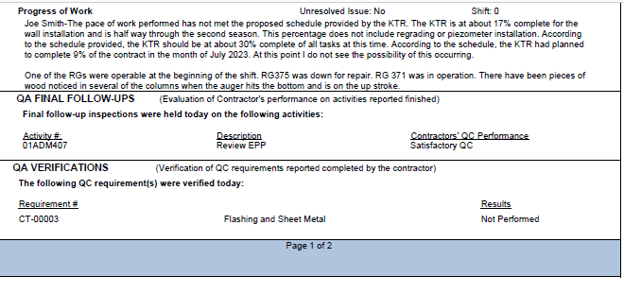
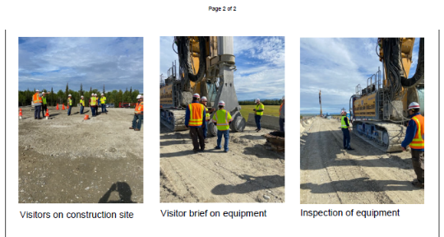
Site visitors – qa Daily log of constr.

Slide 170
Sub-module 6.3 - class work
Individual Work
  Read Module 6.3 and Appendix E
  Answer Questions # 1, 2 Change #1 to read “What are the major components of the QC Daily Report? (sub-module 6.3)
  10 Minutes
Group Work:
  # 3 What Right Looks Like. Review Preparatory, Initial and Daily Reports (Appendix E)
      Group 1 – Compare project schedule to Preparatory, Initial and Daily Report. Does the QC documentation reflect the schedule? Provide examples.
      Group 2 – Preparatory Phase. Identify 3 good practices.
      Group 3 – Initial Phase. Identify 3 good practices.
      Group 4 - Daily Report. Identify 3 good practices.
# 4 (b, c, d, e)
30 Minutes
Pg 65

Slide 171
Sub-module 6.3 - Question 1
    Question #1: What are the major components of the Quality Control Report?
    Answer #1:
    Type of construction underway identified by schedule activity numbers
    Phase of the feature of work, preparatory phase activities, initial phase work, follow-up phase work
    Locations and times of control activities
    Tests performed and results
    Offsite surveillance
    Rework items identified/corrected this date
    Job safety complies with safety plan
    QC Manager’s certification, signature and date
Notes:
Note that report/documentation should tie into schedule

Slide 172
Sub-module 6.3 - Question 2
    Question #2: How often are Quality Control and Quality Assurance Reports required?
    Answer #2: Quality Control Reports are required daily; Quality Assurance Reports are required for each visit day.

Slide 173
Sub-module 6.3 - Question 3
    Question #3: Group Activities:
    What Right Looks Like. Review Preparatory, Initial and Daily Report examples provided in appendix E.
      Group 1 – Compare project schedule to Preparatory, Initial and Daily Report. Does the QC documentation reflect the schedule? Provide examples.
      Group 2 – Preparatory Phase. Identify 3 good practices.
      Group 3 – Initial Phase. Identify 3 good practices.
      Group 4 - Daily Report. Identify 3 good practices.

Slide 174
Sub-module 6.3 - Question 4a
    Question #4a: The G. J. Company has a contract for rehabilitation of three barracks. The work consists primarily of addition of partitions and installation of A/C equipment and ductwork. On the day duct work installation started, the Daily Report stated: "Started installing duct work today. Everything looked okay. Is this report feature adequate? EXPLAIN
Answer #4a:
NO! Following points should be recorded:
Were preparatory and initial phase meetings conducted and, if so, results of those meetings?
Location of work accomplished.
"Okay" is not a satisfactory explanation of contract compliance.
Who is doing work? Subcontractor?
What type of ductwork?

Slide 175
Sub-module 6.3 - Question 4b
    Question #4b: The G. J. Company continues work on rehab contract. Today‘s activities involve the continuation of insulating ductwork. After several review sessions with the contractor regarding proper documentation of activities, his comments were, "Insulation of duct work being done in accordance with specifications. Vapor barrier was ripped in a couple of places and insulator was a little light in use of staples." Rewrite the contractor's comments to make them acceptable.
    Answer #4b:
Following items should be included in the comments:
-location of work,
-reference to review sessions,
-was ripped vapor barrier repaired and how?
-were additional staples added? and
-actions taken to prevent recurrence.

Slide 176
Sub-module 6.3 - Question 4c
    Question #4c: The Paw Power Construction Company has a contract for construction of a high-rise administration building. Work was in early stages of construction and a subcontractor had just completed backfilling sanitary sewer lines. The utilities sub foreman had been designated as QC Manager for this portion of the work. His report was attached to the main report. A preparatory and initial phase had been performed and recorded earlier. This report stated, “All work completed in accordance with directions received at preparatory phase.”
    Answer #4c:
Is it permissible to accept sub reports attached to the Daily Report?
Yes. This should be discussed at the Coordination Meeting.
Is it permissible to reference preparatory phase?
Yes, but date of preparatory phase should be noted to facilitate correlation.
Is anything missing?
Location of work. Reference to specification requirements as well as preparatory phase. Test results of required tests.

Slide 177
Sub-module 6.3 - Question 4d
    Question #4d: Results of Surveillance: Bowers installed base of manhole #2 approximately 10 ft. east of its correct location. Pipe between manholes #6 and #2 is being removed and the pipe between manholes #3 and #2 is being extended to new location for manhole #2. What does this report say? Rewrite the report so that it states clearly what is intended.
    Answer #4d:
    The lack of enough detail in this report leaves you wondering as to exactly what happened and what corrective action was taken. The statement would cause you to believe that manhole #2 was left in the incorrect location and the lines extended accordingly. What the contractor was attempting to state was that they removed the mislocated manhole #2 base and installed all structures in their proper location. Misunderstandings such as the above are not uncommon because of the lack of clarity in QC Reports.

Slide 178
Sub-module 6.3 - Question 4e
    Question #4e: You are the QC Manager. You are to begin installation of ceramic floor and wall tile. Both the floor and the wall are to receive a setting bed. The floor has floor drains and waterproofing has been completed. The wall has electrical receptacles.
    Answer #4e:
Who would you want at the Initial Phase of the work?
Tile foreman and craftsmen. Electrical subcontractor representative. Mechanical subcontractor representative. General contractor representative.
What would you check?
Previous work on floor and wall substrates, Quality of waterproofing, Floor drain location and elevation, Electrical receptacle installation, adequacy of ceramic tile materials including tile, mastic, mortars etc. Do the craftsmen understand the contract requirements?
What items should be contained in the QC Report covering the Initial Phase?
Remembering previous discussions on the initial phase, the QC Report should cover the following, at a minimum: attendees, inspection of preliminary work, safety, establishment of level of workmanship, and resolution of any discrepancies raised.

Slide 179
Testing
Sub-module 6.4
Notes:
Without testing, do you really know if the specified quality has been achieved?

Slide 180
objectives
Discuss objectives of contractor and Government testing
Describe contractor testing procedures
List testing requirements
Pg 67

Slide 181
testing
QC Testing
By Contractor
QA Testing
By Government
Determine if procedures & materials incorporated…are indeed producing required quality…
Verification that QC tests and procedures…are adequate to produce the required quality…
Unannounced
Identify all required testing – Testing Plan
Understand reporting requirements
Lab & personnel acceptable/ certificates/ qualifications
Calibration certificates
Establish procedures for documenting corrective steps if a test fails.
Failed tests must be reported to the government
Notes:
Ask: If you are at a remote site and learn that the calibration certificate has expired, what are the impacts?

Slide 182
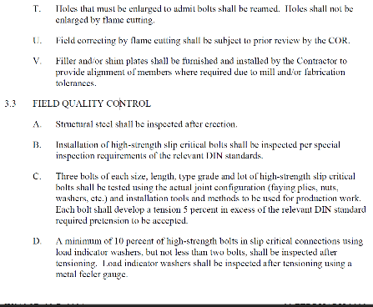
testing
Outline Testing procedures in the QC-Plan
Reference:
  Individual Specification Sections in your contract
  Applicable industry standards (ANSI, DIN, UFC etc)
  Applicable special requirements (e.g. Signal CDS)

Slide 183
Sub-module 6.4 - class work
Read Module 6.4
Answer Questions # 1-5
15 Minutes
Pg 69

Slide 184
Sub-module 6.4 - Question 1
    Question #1: Define QC testing
    Answer #1: QC testing is that testing performed by the contractor to determine
    whether construction procedures and materials are producing the desired
    contractual product.

Slide 185
Sub-module 6.4 - Question 2
    Question #2: Define QA testing
    Answer #2: QA testing is that testing performed by the Government to verify that QC testing is adequate

Slide 186
Sub-module 6.4 - Question 3
    Question #3: Who performs QC tests?
    Answer #3:The contractor may use his own personnel and facilities or may
    employ an independent approved testing laboratory.

Slide 187
Sub-module 6.4 - Question 4
    Question #4: Who performs QA tests?
    Answer #4:
    Government personnel using the contractor's equipment and facilities
    Independent testing laboratory
    Field office, district or division Government laboratory

Slide 188
Sub-module 6.4 - Question 5
    Question #5: What questions should be answered before testing begins?
    Answer #5:
    Has all required testing been identified?
    Are test reporting requirements understood?
    Have laboratory facilities and testing equipment been verified as acceptable?
    Are laboratory personnel qualified?
    has the calibration of equipment been verified as accurate?
    Is there a procedure for documenting corrective steps?

Slide 189
Completion of Work
Sub-module 6.5

Slide 190
objectives
Describe project completion procedures
Pg 70

Slide 191
Contract duration timeline major qc ACTIVITIES
Design & Solicitation
Award
Construction Start
Construction
Construction Complete
Turnover
Red Zone
Commissioning
QC Punch List
Pre- / Final Inspection
Warranty
Final Inspection
Notes:
QC Punchlist to be done by CQC team and recommend having completed punch list at pre-final inspection.
Ask: Who performs the contractor punchout?
- THE CONTRACTOR

Slide 192
QC Activities at closeout
Red zone meeting
Commissioning
Pre-Final Inspection
Establish turnover procedures with all stake holders
Can involve inspections and multiple meetings
Test & balancing equipment/ commissioning report
Usually, period rather than meeting
Hosted by Commissioning Agent
Lead by CQCSM – Contractor / Gov’t inspection
QC Punch-out
Lead by CQCSM
QC develops punch list
Punch list with remaining open items brough to Pre-Final Inspection
CQCSM keeps record of deficiencies found
Deficiencies entered in RMS
Correct Deficiencies
Final-Inspection
Warranty
Turnover
Contractor schedules / manages fixing deficiencies recorded in RMS
Lead by CQCSM – Contractor / Gov’t inspection
DD1354 / Completion Cert.
Warranty Management
CQCSM verifies completion of deficiencies
Based on RMS list; correction verified
CQCSM closes items in RMS
One Meeting – Start Warranty
Hosted by COR / Garrison
On demand / regular / 4- / 9-month inspections
Hosted by COR / Garrison

Slide 193
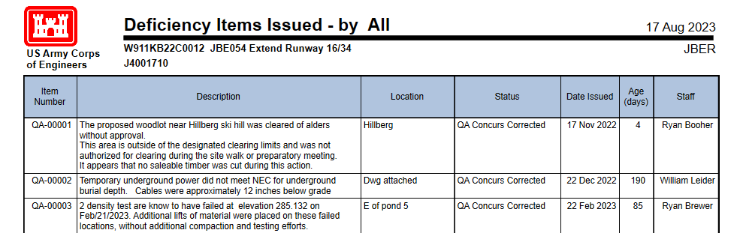
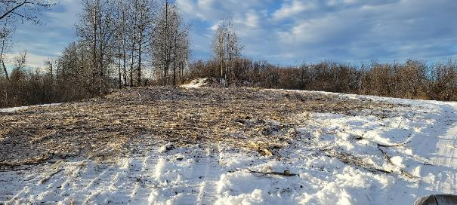
Deficiency items rms example

Slide 194
Closeout considerations
As-Built Drawings
Operation & Maintenance Manuals
Reports (e.g. Commissioning Report)
Special requirements (e.g. LEED)
Training
    (O&M Manuals must be approved prior conducting training)
Keys and spare parts turnover
Warranty management
Notes:
Details for these Red Zone relevant aspects are outlined in the
contract specifications and will be discussed in the Red Zone meeting

Slide 195
Sub-module 6.5 – class work
Read Module 6.5
Answer Question # 1
15 Minutes

Slide 196
Sub-module 6.5 - Question 1
    Question #1:
    What is the appropriate chronological order for the quality management completion procedures listed in this submodule? Explain.
    Answer #1:
    a. Warranty - Documentation of warranties, if any, are provided to the Government at submittal time.
    b. O&M Manuals - Instruction on preparation of equipment must be obtained and understood prior to turning it on. Likewise, if equipment is to be operated correctly, the recommended maintenance of it is necessary to obtain its maximum life.
    c. Testing of Completed systems - Mechanical and electrical systems must be proof tested to prove or ensure such systems will function as intended.
    d. Instruction and Training Procedures - After systems have been proof-tested, proper operation and maintenance of systems is demonstrated to customer O&M personnel utilizing previously prepared manuals.
    e. Contractor Punch-Out - Procedure required for entire project or portions thereof prior to pre-final inspection.
    f. Pre-Final and Final Inspections - Procedures required for acceptance of a project or portions thereof by the Government.
    g. Materials Turnover - Executed at the time of turnover of acceptable work to the customer.
    h. As-Built Drawings - Created throughout the life of the project but provided to the Government at completion.

Slide 197
Making the System Work
Quality
Module 7
Time
Cost
Notes:
In this module we acknowledge that problems can and do occur.
Remember goal is to be pro-active to avoid problems and/or mitigate their impact.
Quality system that is working will greatly assist with the Time and Cost goals.

Slide 198
Objectives
List problems, which may occur during construction.
Name and discuss how requirements may be enforced.
List corrective measures that may be taken by the Government and the authority for each.
Pg 73

Slide 199
Problems / RESOLUTION
PROBLEM CATEGORIES
Delays
Lack/ Error in planning & control
Testing issues
Missing/ incorrect documentation
Misunderstanding CQC responsibilities
RESOLUTION STEPS
IDENTIFY EARLY
RESOLVE AT LOWEST POSSIBLE LEVEL
ELEVATE
The Government makes the final determination (KO-Decision).
The Contractor can file a Claim (for compensation) based on the final determination.
Pg 73
Notes:
Delays – submittals, correction of deficiencies, or because of lack of contractor's acceptance of the CQC principles.
Planning and Control – lack of planning and control and a failure to take corrective action in the planning and control process.
Testing – Improper, inadequate, or untimely testing.
Documentation – Problems occur because of late, incomplete, or incorrect documentation.
Making a written record of quality control action and test results is as important as taking the actions.
If documentation is inadequate, communications break down, and then the legal positions of both the government and the contractor are jeopardized.
Misunderstanding of CQC Responsibility – lack of review of the contract QC requirements, a lack of familiarity with the QC Plan, or failure to communicate roles to other personnel involved in the QC process.
Discuss: Are the resolution steps practical and effective? What is the benefit of identifying the problem early? What happens if you don’t elevate the issue?

Slide 200
When problems occur
Role | Action
CQCSM | Act quickly & confidently! Identify, correct and prevent problems from recurring!
Con Rep | Gov’t is serious about CQC – hold the KTR responsible! Con Rep evaluation of QC system – can be used to provide a final performance rating!

Slide 201
Remedies (if needed) government options
Expose the deficiency/ test/ require replacement
Directive Letter
Hire another contractor (draw the bond)
Payment is for completed work only (i.e. gov’t is not obliged to pay for deficient or incomplete work)
Remove incompetent or require addition QCMs
Stop work
Issue Unsatisfactory Appraisal
Terminate the contract for default
Pg 74

Slide 202
Making the system work
FIRST…..
Read contract
Think proactively
Plan / Plan again / Replan
Relationships; CQCSM – Con Rep
Document
Partnering
Pg 75

Slide 203
MODULE 7 - CLASS work
Read Module 7
Answer Questions # 1-3
  Question #4 Group work
    4.b - Group 1
    4c - Group 2
    4f - Group 3
    4j - Group 4
20 Minutes
Pg 77

Slide 204
MODULE 7 – question #1
Question #1:
Name the categories of problems that normally occur during construction.
Answer #1:
• delays
• planning and control
• testing
• documentation
• misunderstanding of CQC responsibility

Slide 205
MODULE 7 – question #2
Question #2:
What options are available to the Government under the Contract Clauses of the contract?
Answer #2:
Requiring the contractor to remove and replace deficient materials and/or workmanship.
Withholding payment.
Requiring removal of unqualified personnel.
Requiring the contractor to assume personal supervision.
Halting work.
Issuing an unsatisfactory performance appraisal.
Terminate the contract.

Slide 206
MODULE 7 – question #3
Question #3:
What is the preferred resolution for any problem that occurs?
Answer #3:
Class Discussion

Slide 207
MODULE 7 – question #4
Question #4:
Analyze the cases on the following pages and answer the questions included with each. Be prepared to discuss your answers with other members of the class.
Answer #4:
Class Discussion

Slide 208
MODULE 7 – question #4a
Question #4a:
Contractor is constructing a commissary. The contract was awarded in April, which allowed for sufficient time to enclose the building before onset of cold weather. Building is scheduled to be complete in May of next year, which necessitates doing the inside finish work during winter months. The customer has scheduled delivery of equipment and stock for June. Work was progressing satisfactorily, and the contractor was about to start roofing operations in mid-September when the resident engineer discovered the contractor was installing untreated lumber for edge strips, curbing, etc., which was in violation of the specifications. Work was stopped, and after some investigation, contractor advised the resident engineer that the best delivery on treated lumber was eight weeks, which would delay enclosing the building and ultimately delay turnover to the customer. The contractor requested waiver of treated lumber requirement.

Slide 209
MODULE 7 – question #4a1
Question #4a1:
Where did the contractor's control system break down?
Answer #4a1:
Obviously, an effective Preparatory Phase meeting should have addressed the subject of "treated lumber" as this has been historically a repetitive problem in roofing operations. Further, the specifications usually require certain contractor submittals on treated lumber. Therefore, the contractor's CQC system failed from the absence of, or an inadequate Preparatory Phase meeting.

Slide 210
MODULE 7 – question #4a2
Question #4a2:
Where did the Government assurance system break down?
Answer #4a2:
The Government's system broke down when by not assuring that the contractor had conducted a proper Preparatory Phase. Further, it should have been noted from an examination of the contractor's QC reports the lack of this important phase. Also, the Government failed to monitor the submittal register.

Slide 211
MODULE 7 – question #4a3
Question #4a3:
What are the resident engineer's courses of action?
Answer #4a3:
Pursuant to the terms of the contract, the resident engineer must now reject the improper material and require contract compliance. The resident engineer should also question, in writing, the adequacy of the Contractor's Quality Control system and require immediate management corrective action.

Slide 212
MODULE 7 – question #4b
Question #4b:
Contract involves construction of a major barracks complex including 25 dormitories. Project is 75% complete and occupied by troops when the customer complains that the opaque panel in lower window section is allowing precipitation to penetrate during driving rain. The leaks have stained carpet and ceiling tile. Investigation reveals that leaking panels are improperly glazed and do not conform to the contract drawings or specifications. All windows had been factory glazed and were warehoused onsite. Although a vinyl strip covered the glazing, careful examination of the windows prior to, and after installation would have revealed the construction deficiency.

Slide 213
MODULE 7 – question #4b1
Question #4b1:
Identify the steps within the CQC system that failed, thereby creating the construction deficiency.
Answer #4b1:
There was an absence of, or inadequate, Preparatory Phase meeting, which would have included examination of materials and comparison to shop drawings when materials were delivered to the jobsite. Because of the volume of windows involved, CQC directly related to offsite fabrication should have been addressed during the Coordination Meeting. A visit by the contractor to the fabricator's plant during the fabrication process would have been in order.

Slide 214
MODULE 7 – question #4b2
Question #4b2:
Identify the steps within the Government's QA system that failed to detect the breakdown in the contractor's QC system.
Answer #4b2:
The Government did not assure itself that the contractor had scheduled or conducted a Preparatory Phase. The Government representative conducting the Coordination Meeting did not address the subject of offsite fabrication or examination of materials or equipment when delivered to the project site. QC Report review by QA personnel should have revealed lack of adequate Preparatory Phase.

Slide 215
MODULE 7 – question #4b3
Question #4b3:
Keeping in mind that there are 4,200 windows involved in the contract, what corrective measure should the resident engineer employ?
Answer #4b3:
Contractor should be immediately advised in writing, by the Contracting Officer's Representative to cease installation of windows until compliance with the contract is demonstrated. Problem is of such a magnitude that Contract Clause, "Inspection of Construction," will be invoked formally to require the contractor to examine and expose an adequate sampling of windows throughout the project. It is possible the Government may be liable for some payment if the examination reveals some contract ambiguity, but the severity of the problem is such as to warrant the risk.

Slide 216
MODULE 7 – question #4b4
Question #4b4:
What action should be taken on remaining buildings not completed?
Answer #4b4:
The contractor should be required to immediately convene a Preparatory Phase meeting and all aspects of the window installation should be reviewed by the contractor in detail before any further work on this feature progresses. The contractor should be required to increase his QC surveillance until they demonstrate contract compliance.

Slide 217
MODULE 7 – question #4b5
Question #4b5:
Assume, because of the magnitude of the problem, that the contractor and window manufacturer refuse to comply with your directive; what tools in the contract does the resident engineer resort to?
Answer #4b5:
The contractor should again be directed in writing by the Contracting Officer to correct the defective windows. A definite suspense date should be established in this letter for effecting the correction. The contractor should be advised that if correction is not accomplished by that date, pursuant to the contract, another contractor will be employed to make the correction and they will be back charged for the cost. Further, a copy of this correspondence should be forwarded to the contractor's surety company. Many times, this generates immediate action. Reference to the payment Contract Clause and the Contractor Performance Appraisal may also create some activity on the contractor's part.

Slide 218
MODULE 7 – question #4c
Question #4c
Contract is for a large barracks complex involving 47 buildings. There are 1,500 fan coil units to be installed throughout the project. As the fan coil units were delivered to the site, the mechanical subcontractor discovered that the units contained a 1/2" valve in lieu of a 3/4", as indicated on the contract drawings. Contractor's shop drawings also indicated a 3/4" valve. Contractor immediately advised the resident engineer of the discrepancy. Contractor further advised that supplier's standard unit is furnished with a 1/2" valve and requested permission to use units as delivered. All units were delivered in one large shipment, and some were needed for immediate installation.

Slide 219
MODULE 7 – question #4c1
Question #4c1:
Was the subcontractor's quality control system working?
Answer #4c1
The subcontractor's quality control system was working. They had examined equipment immediately upon delivery to the job site and advised the prime contractor. However, the subcontractor might have visited the supplier's plant during fabrication because of quantity involved.

Slide 220
MODULE 7 – question #4c2
Question #4c2:
Where does the supplier fit into the problem?
Answer #4c2:
The failure rests with the supplier for not correlating the shop drawing with the manufactured item. Again, because of the magnitude of the order, there should have been a closer communication between the supplier and the subcontractor. This is a breakdown in QC. The prime contractor is ultimately to blame for not fulfilling the responsibility to assure the subcontractor and the supplier were communicating.

Slide 221
MODULE 7 – question #4c3
Question #4c3:
What measures should Government QA personnel now employ?
Answer #4c3:
QA personnel should instruct the contractor not to install any of the units until the problem is resolved.

Slide 222
MODULE 7 – question #4c4
Question #4c4:
In this instance, should the resident engineer investigate possible design error in specifying a 3/4" valve?
Answer #4c4:
The resident engineer should investigate the possibility of a design error as the Government normally specifies a manufacturer's standard unit. If a drafting error on the plan is discovered as the cause, a modification should be issued changing the 3/4" valve to 1/2" with an equitable credit to the Government.

Slide 223
MODULE 7 – question #4d
Question #4d:
Project includes several masonry buildings requiring joint reinforcement. Contractor proceeded with sample masonry panel erection without approved materials despite Government QA personnel objection. Contractor has now completed wall erection on one building and Government QA personnel discover the contractor is using wrong joint reinforcement. Contractor superintendent states bar joists will be erected tomorrow morning.

Slide 224
MODULE 7 – question #4d1
Question #4d1:
What questions first come to mind as to the effectiveness of the contractor's quality control system?
Answer #4d1:
Obviously, the contractor has not employed an effective CQC system since the start of the project. Deficiencies such as depicted do not occur if proper preparatory phase was conducted.

Slide 225
MODULE 7 – question #4d2
Question #4d2:
Where did the Government's quality assurance role first break down?
Answer #4d2:
Basically, the Government has failed in its Quality Assurance role by allowing the contractor to progress to this point without an effective CQC system. Government QA personnel have not employed the contractual remedies available to correct the situation before it deteriorated this far.

Slide 226
MODULE 7 – question #4d3
Question #4d3:
What Contract Clauses should be employed by the resident engineer at this point in time?
Answer #4d3:
Direct the contractor under the "Inspection of Construction" clause to cease masonry work until work has been corrected.
Under the "Withhold Payments Contract Payment" clause withhold payment for any deficient work.
Under the "Material and Workmanship" clause remove the contractor's QC representative as incompetent.
The contractor should be advised of all the above in writing over the Contracting Officer's signature. The contractor should also be told that the resident engineer is considering the issuance of an interim unsatisfactory performance appraisal if improvement to the CQC system is not initiated.

Slide 227
MODULE 7 – question #4e
Question #4e:
Project is a small flood control dam with reinforced concrete outlet structure.
Contractor testing requirements are specified in detail and require full-time
quality control personnel at concrete batch plant. Concrete production has
commenced, and after one-week concrete cylinder breaks indicate extremely
low compressive strength. It is immediately discovered that the plant
measuring devices had not been calibrated.

Slide 228
MODULE 7 – question #4e1
Question #4e1:
What is the Government's first corrective action to be taken?
Answer #4e1:
The Government must direct contractor to stop placement of concrete.

Slide 229
MODULE 7 – question #4e2
Question #4e2:
What apparent deficiency existed in the contractor's quality control system?
Answer #4e2:
Lack of an adequate Preparatory Phase, which would have addressed calibration of the plant.

Slide 230
MODULE 7 – question #4e3
Question #4e3:
Basically, where did the Government quality assurance role fail?
Answer #4e3:
Lack of an adequate Coordination Meeting, which should have addressed calibration and testing, in general. It is apparent also that the Government had not insisted that the contractor conduct a Preparatory Phase meeting prior to the start of concrete operations.

Slide 231
MODULE 7 – question #4e4
Question #4e4:
What Contract Clauses must now be employed by the Government?
Answer #4e4:
Require the contractor to demonstrate strength of concrete in place. If found deficient, require removal and replacement. (CC“ Inspection of Construction")
Withhold all payment for placed concrete until situation is corrected.(CC "Withhold Payment - Contract Payment")
Caution contractor on competency of his QC representative. (CC“ Material and Workmanship")

Slide 232
MODULE 7 – question #4f
Question #4f:
On an underground electrical distribution project, the contractor was to
install a run of 2/0 cable in the system. The project had been
completed and accepted two years ago, when it was discovered that
this run of cable was #2 instead of 2/0 and totally inadequate for the
future load.

Slide 233
MODULE 7 – question #4f1
Question #4f1:
What corrective measure, if any, is available to the Government to have the deficient cable replaced?
Answer #4f1:
The Contract Clause "Inspection of Construction," states that acceptance shall be final and conclusive except for latent defects, fraud, gross mistakes amounting to fraud, or the Government's rights under any warranty or guarantee.
In this instance, this deficiency falls within the category of a gross mistake. Contractors should be required to replace cable. Contractor's surety should be notified if contractor contests action.

Slide 234
MODULE 7 – question #4f2
Question #4f2:
Should the contractor's quality control system and Government's assurance system prevent isolated instances of this type? How?
Answer #4f2:
If a proper Initial Phase had been conducted, a problem such as this could have been avoided.
Follow-Up Phase should have revealed the deficiency.

Slide 235
MODULE 7 – question #4g
Question #4g:
The contract for construction of the outlet works at a flood control and recreation reservoir required steel gates. The prime contractor subcontracted the gates to a fabricator in Los Angeles. All CQC requirements on the gates were delegated to the fabricator. The resident engineer arranged for Government periodic QA visits to the plant. The plant inspector advised the resident engineer that the welding procedures and the welders had not been certified prior to commencement of fabrication. The QC report contained no entry on this subject.

Slide 236
MODULE 7 – question #4g1
Question #4g1:
In this instance, what role does the prime contractor assume?
Answer #4g1:
In this instance, the general contractor assumed a QA role as they had delegated the CQC responsibility to the fabricator.

Slide 237
MODULE 7 – question #4g2
Question #4g2:
Where did the prime contractor fail in the quality control system?
Answer #4g2:
They no doubt did not outline the CQC requirements to the fabricator and in his QA role the prime contractor did not follow-up on the CQC procedures at the plant.

Slide 238
MODULE 7 – question #4g3
Question #4g3:
Where did Government's QA role break down?
Answer #4g3:
During the Coordination Meeting the subject of offsite fabrication was not thoroughly discussed so that the prime contractor fully understood his role.
The Government may have also noted the deficiency through a proper review of the daily QC reports.

Slide 239
MODULE 7 – question #4g4
Question #4g4:
What steps does the Government take now?
Answer #4g4:
The Government must direct the contractor to cease fabrication until all required procedures have been met.
Require the contractor to demonstrate contract compliance on previously fabricated work. Withhold payment on gates until contract quantity is satisfied.

Slide 240
MODULE 7 – question #4h
Question #4h:
The contract was for construction of multipurpose classrooms at the Air Force Academy. The rooms were to receive carpet that had been color-coordinated with the room furnishings. Carpet was scheduled for delivery 1 Aug, which allowed only three weeks for laying and completion of project prior to start of classes. Carpet was delivered 1 Aug and it was immediately discovered that the carpet did not adequately match the approved sample.

Slide 241
MODULE 7 – question #4h1
Question #4h1:
Could the CQC system have prevented this? How?
Answer #4h1:
Yes. If offsite fabrication and CQC requirements related thereto had been properly addressed, the prime contractor would have assured himself that the match was satisfactory during manufacture.

Slide 242
MODULE 7 – question #4h2
Question #4h2:
Did the Government fail in its QA role by not inquiring as to the status of carpet manufacture?
Answer #4h2:
Yes. In the Government's QA role, it should continually question the contractor as to the status and quality of his offsite fabrication and procurement.

Slide 243
MODULE 7 – question #4h3
Question #4h3:
What steps should the Government take now?
Answer #4h3:
Reject the delivered carpet and insist on compliance.
Coordinate the delay with the customer and reschedule carpet laying outside class hours to avoid conflict.

Slide 244
MODULE 7 – question #4i
Question #4i:
Contractor on a major multi-building project started his first concrete placement
this morning. Contractor is placing a monolithic foundation using a leased
concrete pump truck. Two-thirds of the foundation had been placed when the
concrete pump failed. No standby placement equipment was available as
required by the contract, which created a cold joint before the pump could be
repaired.

Slide 245
MODULE 7 – question #4i1
Question #4i1:
What was the first step that failed in the contractor's QC program?
Answer #4i1:
Total lack of Preparatory Phase and Initial Phase on concrete placement.

Slide 246
MODULE 7 – question #4i2
Question #4i2:
How could the Government's QA role have prevented this incident?
Answer #4i2:
In the Government's assurance role, they should know whether the contractor is following the three-phase control system on definable features of work.
The lack of a Preparatory Phase meeting on concrete should be discovered when examining the contractor's QC reports, as these significant events should be recorded.

Slide 247
MODULE 7 – question #4i3
Question #4i3:
Would proper QC reports alert us to a failure of this type in the system?
Answer #4i3:
Yes, the contractor should record all Preparatory Phase minutes.

Slide 248
MODULE 7 – question #4i4
Question #4i4:
What corrective measures should the Government employ to prevent further incidents of this type?
Answer #4i4:
Require the contractor to cease concrete operations until alternate equipment is available;
require the contractor to convene Preparatory and Initial Phase meetings and thoroughly discuss all aspects of concrete placement.
Review QC Report requirements with the contractor insisting that the three-phase system of control be recorded properly.
Question the effectiveness of the contractor's QC representative.

Slide 249
MODULE 7 – question #4j
Question #4j:
An airfield project involved placement of a concrete apron for helicopters. The
specifications required the use of jet fuel-resistant joint sealant. The sealant
was required to be Government tested and approved prior to use. The
specifications further required that the joints be sealed immediately after the
curing period. Contractor started placement of concrete when it was discovered
that the sealant had not been submitted for testing.

Slide 250
MODULE 7 – question #4j1
Question #4j1:
In what meeting should the testing requirements of the contract be discussed in general?
Answer #4j1:
The Coordination Meeting.

Slide 251
MODULE 7 – question #4j2
Question #4j2:
At what phase should this specific testing have been discussed?
Answer #4j2:
The Preparatory Phase meeting should address specific testing on the definable feature of work.

Slide 252
MODULE 7 – question #4j3
Question #4j3:
Within the Government's QA role, where should it have detected this deficiency?
Answer #4j3:
The Government should have noted the lack of an adequate Preparatory Phase meeting.
Its review of the contractor's QC Reports should be alerted to this problem.
The review of the submittal register status should also reveal the deficiency.

Slide 253
MODULE 7 – question #4j4
Question #4j4:
What corrective measures do we use now?
Answer #4j4:
Cease concrete placement until the contractor demonstrates how they will satisfy contract requirements on future placement.
Explore with the contractor the possibility of his voluntary use of a temporary seal on concrete previously placed until proper material has been tested.
Ensure that any temporary seal is at no additional cost to the Government.

Slide 254
Resident Management System (RMS 3.0)
Contractor Mode (CM) & Government Mode (GM)
Module 8
Sub-modules 1 & 2

Slide 255
OBJECTIVES
RMS development history
General capabilities
We will not be working thru them in class
Review on your own time
Pg 81

Slide 256
What is rms?
Construction Management Tool
Used to facilitate
  Required documentation (dailies, submittals, RFIs, pay estimates, etc.)
  Contract administration
  Financial management (How you get paid!!!)
Government Mode (RMS-GM)
Contractor Mode (RMS-CM)
Pg 81

Slide 257
Rms functions
QC Daily Reports
Submittal and RFI Management
Progress Payments
Correspondence Tracking
Contract Modifications
Deficiency Tracking
Safety/Accident Reporting
Pg 82

Slide 258
Benefits of rms
Simple to use
Streamline contract administration
Provides single location for required documentation
Simplifies progress payments
Pg 85

Slide 259
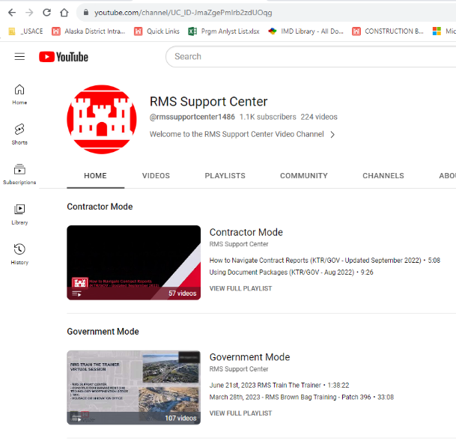
Rms support
RMS Website
  https://rms.usace.army.mil/
RMS Support YouTube Channel
  https://www.youtube.com/@rmssupportcenter1486
RMS Help Desk
  (442) 333-1011
  https://astrafirerms.atlassian.net/servicedesk/customer/user/login?destination=portals

Slide 260
Introduction to rms operation

Slide 261
OBJECTIVES
Navigating within the RMS program
Entering official correspondence
Submitting Requests for Information (RFI’s)
Entering QC Daily Reports
Creating Transmittals

Slide 262
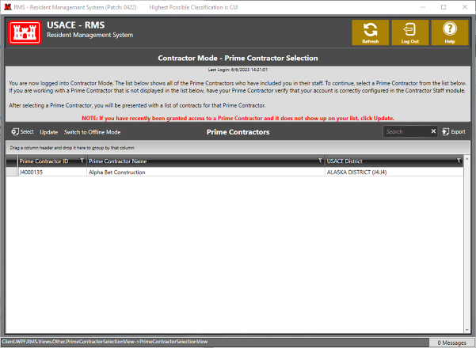
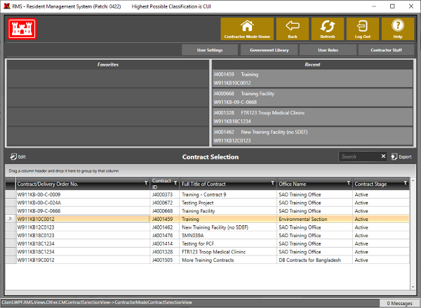
Accessing the project

Slide 263
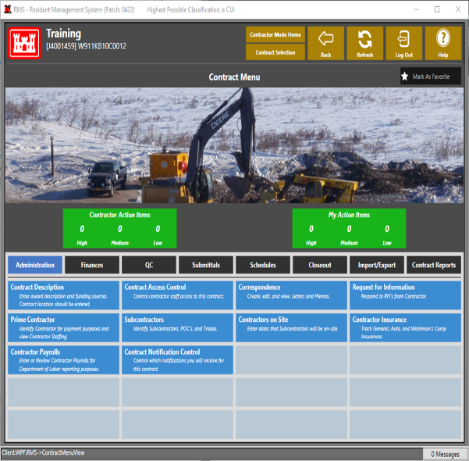
Project home screen
At the top left of the screen the contract name and number are shown
The navigation bar at the top right of the screen lets you back out of or refresh your current screen, quickly select a different contract, or log out
The navigation bar at the center of the screen lets you scroll through various windows
Each window contains a list of modules that are grouped into categories
The modules you’ll use most inside the Administration window are the Correspondence and Request for Information

Slide 264
correspondence
The Correspondence module is where you will generate and send serial letters to the Government, and access serial letters and RFPs sent by the Government to you
To access the Correspondence module, click on the Correspondence button in the Administration window

Slide 265
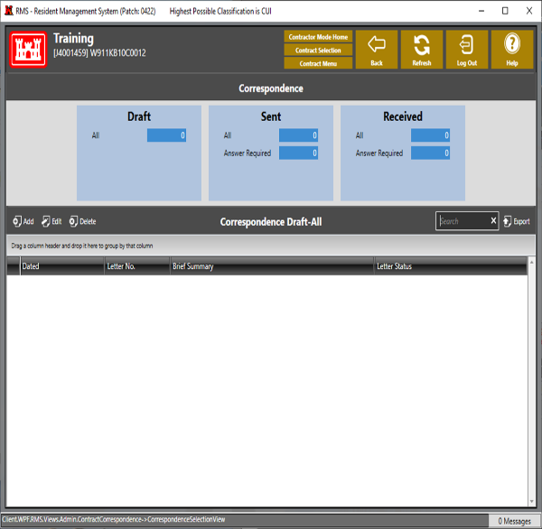
Correspondence continued
RMS will bring you to the Draft window of the Correspondence module
By clicking on the blue boxes at the top, you can also filter by Sent or Received correspondence
To generate new correspondence, click the Add button at the center, left of the screen
You will see the options Letter from Contractor Home Office or Letter from Contractor Site Office
You will select the more appropriate option for your situation, but for now we’ll select Site Office

Slide 266
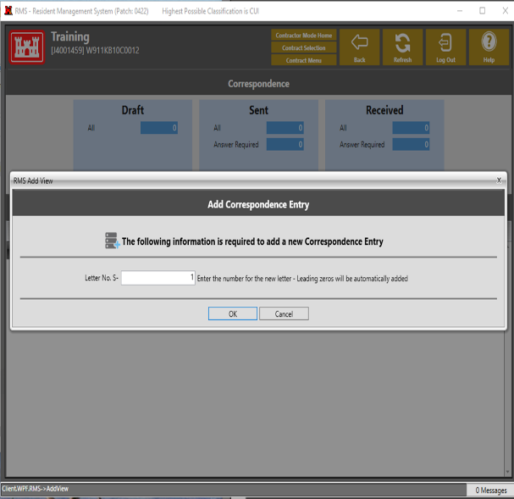
Correspondence continued
This is the screen where you will select the serial letter number
Serial Letters from both the Home and Site Offices must be generated in order. Numbers should not be skipped
If a serial letter is drafted and is ultimately not used, It should remain in RMS and be titled Not Used rather than being deleted

Slide 267
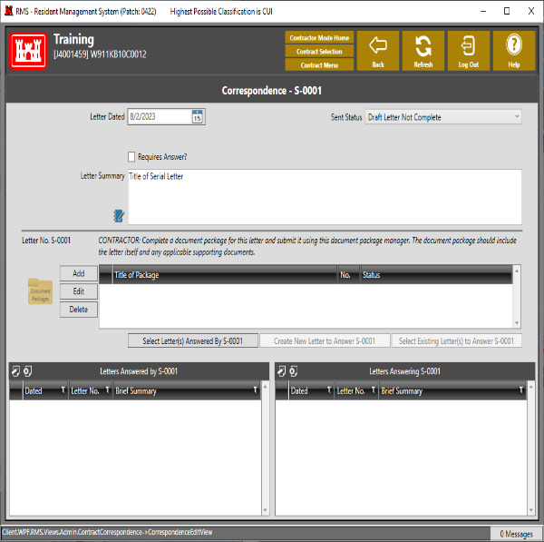
Correspondence continued
Clicking Ok brings you to this page
Most of the information is self explanatory
The Letter Summary should contain the title of the serial letter, which should convey a brief summary of the letter
Please do not provide a detailed summary of the serial letter in this block
To add the actual letter, click the add button on the center, left of the screen

Slide 268
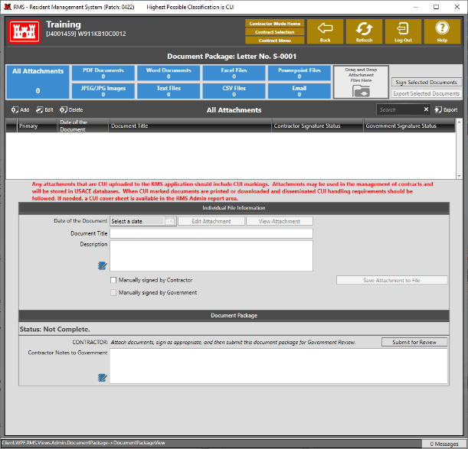
Correspondence continued
This screen is where you add the actual correspondence
Clicking the add button at the top, left lets you browse your file system for the documents
You can also drag and drop files from your File Explorer directly onto the white field at the top, center
The serial letter should be a pdf file, and should be signed by an authorized signatory in your organization
You can also attach supporting documents (photos, Excel files, other pdfs, etc.) however, the Government prefers all documents be included in a single pdf file with the 1st page being the serial letter

Slide 269
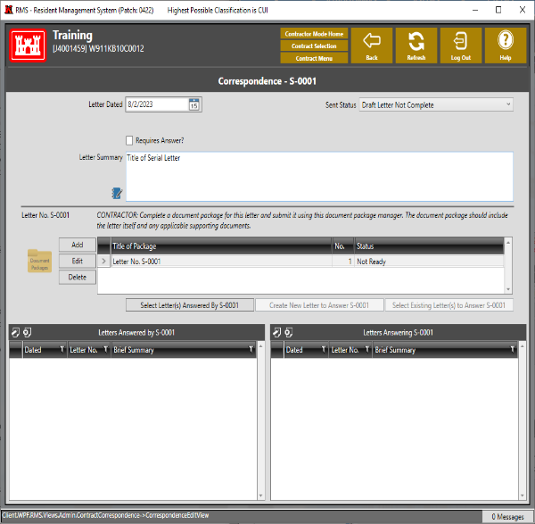
Correspondence continued
After adding correspondence, click Back to return to this screen
You will see a document package has been added, and you have the option to Edit or Delete
Below the document package block, select the box Select Letter(s) Answered By in order to select prior serial letters answered by this one, if applicable
Finally, once everything is complete and ready for the Government, use the Sent Status dropdown menu at the top, right to select Draft Letter Complete Sent to Government to send to the Government for review

Slide 270
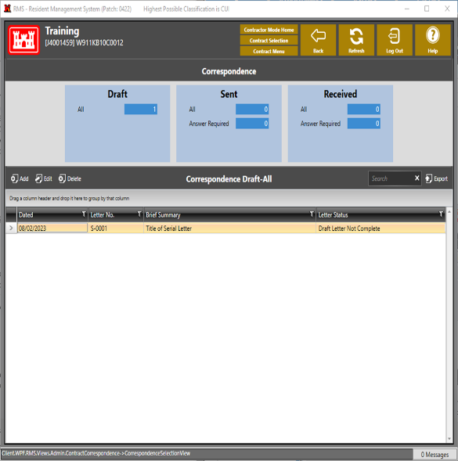
Correspondence continued
Backing up one screen shows the serial letter document package has been created and is in the draft window
The draft serial letter can be edited or deleted as needed
Once sent to the Government, it will move to the Sent window
RFI’s and serial letters sent to you by the Government will appear in the Received window

Slide 271

Request for information
RFI’s are an official channel for you to get questions regarding the Contract (specs and drawings) answered
Back on the Project screen, select the Request for Information module

Slide 272
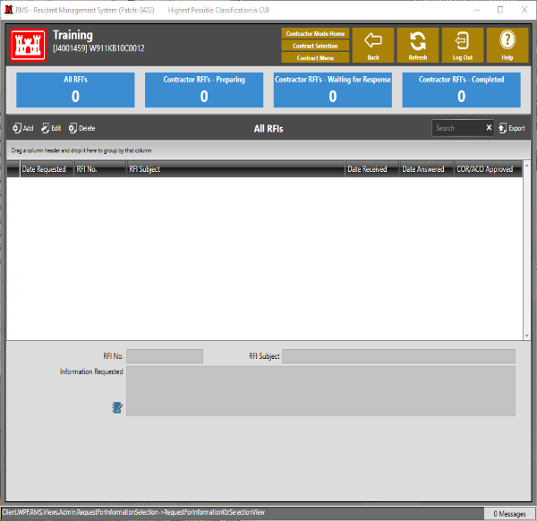
Request for information continued
This window allows you to view, create, and edit RFI’s on the current project and shows their status
The blue boxes at the top allow you to filter previously generated RFI’s by all, those being prepared, those awaiting response, and those answered by the Government
To create a new RFI, click the Add button at the top, left

Slide 273
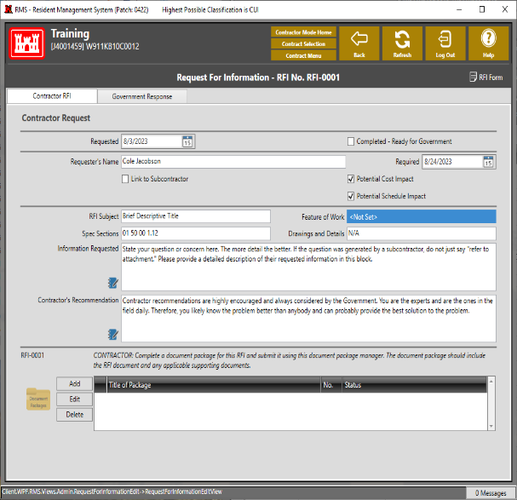
Request for information continued
Creating a new RFI will bring you to this screen
Fill out all the information to the best of your ability
If a section is not applicable, be sure to mark it as such
Be sure to include the date you need your answer and check the Potential Cost/Schedule Impact boxes if you think a Contract Modification will result
Any corresponding documents (photos, sketches, email chains, etc.) can be attached to the document package at the bottom
Do not press the Completed-Ready for Government checkbox until everything is complete. You will lose the ability to edit once you do

Slide 274
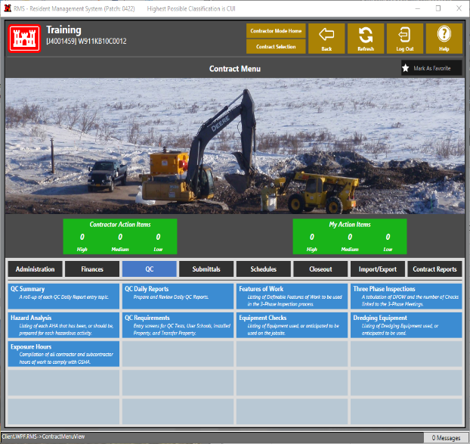
Daily reports
To create a daily report, return to the project home screen, click on the QC window, and then on the QC Daily Reports module

Slide 275
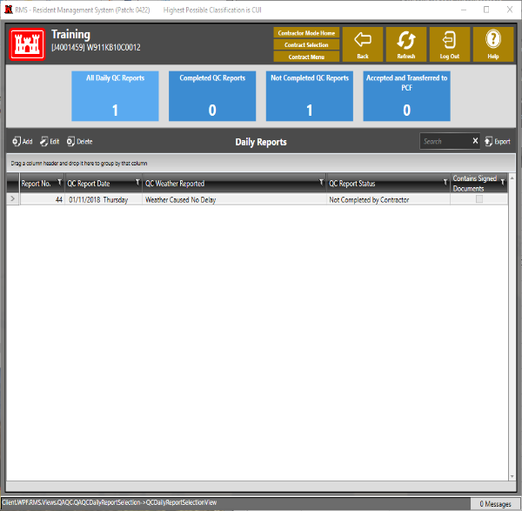
Daily reports continued
The blue boxes at the top allow you to filter previously created daily reports by all, completed, not completed, and accepted by the Government
Clicking Add at the top, left will create a new daily report
A report is required for each workday, and at least 1 report per week during shutdown periods

Slide 276

Daily reports continued
After clicking Add, you will be prompted to select the date for the daily report
Select the day that corresponds to the date for which you are submitting the report and click OK

Slide 277

Daily reports continued
After selecting the date, you will arrive on this screen
The blue boxes on the left of the screen are used to input data to the daily report. Simply click on a box and enter any data applicable to that category
When all the applicable categories for the daily report are filled out, click the Generate QC Report in Document Package. This will automatically pull all the information you entered into the daily report and upload it to the document package
Next, either click the Edit button to the left of the document package, or double click on the package you wish to edit

Slide 278

Daily reports continued
You will then be brought into the document package window and will be able to upload any other relevant documentation (meeting minutes for preps/weekly meetings/tailgate safety meetings, inspection reports, photos, etc.)
After uploading all relevant documents, you will sign the QC daily report, and click submit for review
Steps for signing are covered on the subsequent slides

Slide 279

Signing a report
After clicking Sign Selected Reports, you will be brought to this screen
Select the document you wish to sign and click Next at the bottom

Slide 280

Signing a report continued
Enter Quality Control Manager as your title and click Use Signature Title for future signatures if desired
Ensure the Digital Signature Position is set to Military QC Report – QC Representative and click finish
This will sign the document and take you back to the document package

Slide 281

transmittals
To generate a transmittal, return to the home screen
Click the Submittals tab followed by the Transmittal Log button

Slide 282

Transmittals continued
The transmittal log provides a list of all previous transmittals and their status
The blue bar at the top can be used to group by Draft, In-Review, or Completed
To create a new transmittal, click add at the top, left

Slide 283

Transmittals continued
Select the specification section applicable to the submittal being generated
Note: For a resubmittal item, you may have to click the All Sections checkbox at the top left for the right spec section to appear in the list
Once selected, click Next at the bottom, right

Slide 284

Transmittals continued
Click on the desired submittal item or items (multiple submittal items from a given spec section can be submitted simultaneously)
For resubmittals, the All Submittal Items checkbox at the top left may need to be checked for the necessary submittal items to appear on the list
Click Next at the bottom, right
Click Finish on the follow up screen without changing any of the information

Slide 285

Transmittals continued
Add any comments you want to appear on the Eng Form 4025 in the Contractor Remarks to Government section
Click the Add button at the bottom to add a document package similar to Correspondence, RFIs, Daily Reports, etc.
If the submittal includes a variation from the contract, ensure the variation checkbox is checked and the Government is informed
Once complete, ensure the Date Prepared date is correct, and click the Create and Digitally Sign 4025 button at the bottom, right

Slide 286
Course REVIEW
Notes:
Closed book
Closed neighbor
Score does not matter
Read the questions carefully, make a mental note of vocabulary you might not be familiar with

Slide 287
Course Survey
Notes:
Closed book
Closed neighbor
Score does not matter
Read the questions carefully, make a mental note of vocabulary you might not be familiar with

Slide 288
Course survey
Please provide feedback
location
class size
Did you learn?
What would make the class better?
Prefer online?

Slide 289
Post test
Post Test:
70% required to pass the course
Closed book / closed neighbor
No retests, must pass on first try
Read questions carefully, take your time.
When complete give to Ruby and wait quietly out of respect for those still taking the test
If you have a time crunch let us know

Slide 290
Post-test

Slide 291
Instructors
Role | Name | Work Number | Work E-mail
Course Instructor
 | John Dutton | (907) 377-4049 | John.V.Dutton@usace.army.mil
 | Jason Eckstein | (907) 753-2881 | Jason.C.Eckstein@usace.army.mil
 | Cole Jacobson | (907) 753-5651 | Cole.V.Jacobson@usace.army.mil
 | Colleen Jordan | (907) 753-2888 | Colleen.L.Jordan@usace.army.mil
 | Tuan Lai | (907) 753-5500 | Tuan.Q.Lai@usace.army.mil
 | Chuck Livers | (907) 753-2698 | Charles.J.Livers@usace.army.mil
 | Andrew Posma | (907) 356-6712 | Andrew.J.Posma@usace.army.mil
 | Saundra Ward | (907) 201-5137 | Saundra.L.Ward@usace.army.mil
District CQM Course Manager | Marion Dawag | (907) 753-5640 | Marion.E.Dawag@usace.army.mil
Division CQM Course Manager | Ed Yago | (907) 835-4682 | Edward.M.Yago@usace.army.mil
Notes:
Current list of USACE CQM Instructors.
Introduction of the Instructors (use same student introduction format)
Name
Number Years working at USACE
Experience in CQM
Hobby/Interests

