Slide 1

Alaska Construction: Earthwork
Notes:
Introduce the group/industry that we represent.

Slide 2
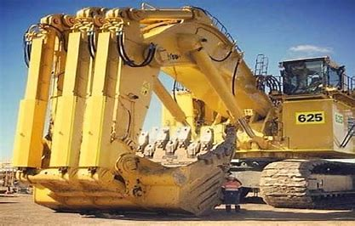
Heavy Civil Construction
“Dirt Work” or “Earthwork”
We build things
Small to HUGE equipment
Heavy Civil Industry
  Pays very well
  Benifits
Notes:
Heavy Civil construction will sometimes be referred to as “Dirt Work or Earthwork”, and yes we do get to play in the dirt.
One of the coolest things about construction is that we get to build things. Examples: parking lots, roadways, bridges, foundations for buildings, etc…
We also get to play with equipment.
Our industry puts a ton of effort into making sure our workers are well taken care of. Taken care of not just financially but we are looking out for them by offering training, insurance, and retirement.
View the picture and point out the human standing beside the bucket.

Slide 3
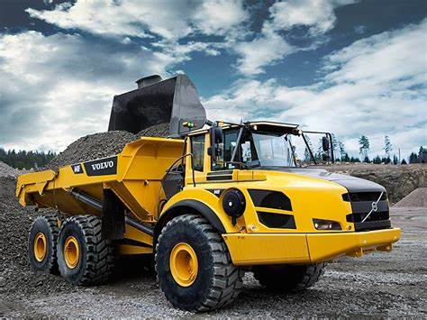
Opportunities
Project management, HR, IT, accounting, quality control.
Operators, laborers, truck drivers, foreman, grade checkers, traffic supervisors, and flaggers.
Notes:
Engage the students on how this topic can result in employment. Explain all the different paths of employment within the industry.

Slide 4
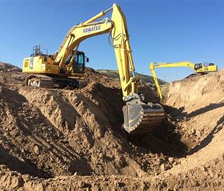
Dirty Details
Terms:
  soil
  topsoil
  mud
  silt
  clay
  caliche
  bed rock
  peat
Notes:
Discuss the different types of “dirt”, let the students come up with what they can.
All types of dirt have differing properties which is what they are made up of and how much they weigh.
Think of it like mammals. A human and a whale have some similar traits but we don’t look, feel, or weight the same.

Slide 5
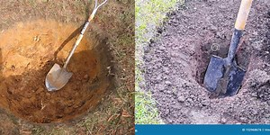
Bank -> swell -> Loose
Dirt in its natural state = “bank”
When you loosen dirt by disturbance
Grow in size by about 25%
This represents it in a “loose” state
Notes:
Explain how dirt just naturally in place is called “bank” yards. Just sitting there with all the natural elements like gravity and rain. Again, we would call this a “Bank Yard”.
When you loosen dirt by disturbance, like digging a hole with a shovel, takes material out of its natural or bank state.
Have you ever noticed that when you try to put the material you dug out of the hole back in it doesn’t exactly fit? You have added air and sometimes reduce moisture content. The pile is just not the same size as the hole without using some sort of force to put it back in.
Loosening a “Bank Yard” tends to “Swell” about 25%. This mainly is that you are adding air voids to the material.
This represents dirt being in a “loose” state. We would call this a “Loose Yard”.
Reassure the students that this will all make sense and is important when we do the shop experiment.

Slide 6
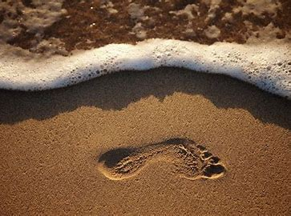
Bank -> shrink -> Compacted
Dirt in its natural state = “bank”
When you compact dirt
Shrink in size by about 20%
This represents it in a “compacted” state
Notes:
Refer the students back to a “Bank Yard”, material that is in its natural resting state.
When you compact dirt by adding pressure, like stepping in the sand on a beach, you are taking the material from its natural state “Bank” to a compacted state.
Compacting natural material from a bank state to a compacted state typically “Shrinks” by about 20%.
This is what we call taking a “Bank Yard” to a “Compacted Yard”.
Reassure the students that this will all make sense and is important when we do the shop experiment.

Slide 7
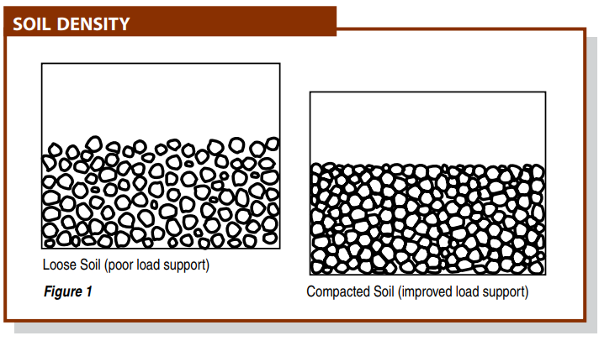
Soil (dirt) Density
Why Compact?
There are five reasons to compact soil:
Increases load-bearing capacity
Prevents soil settlement and frost damage
Provides stability
Reduces water seepage, swelling and contraction
Reduces settling of soil
Notes:
Typical soil is naturally at a 92% compaction. Target stabilization for stabilized ground to build on is 96% compaction.
How many people notice how our roads in Alaska will grow and shrink during freeze/thaw conditions. This is the moisture that is in the material freezing and thawing.
You wouldn’t want to build a school or house on ground that has half of it compacted and the other half not compacted. You would get settling and your building would lean and ultimately crack.

Slide 8
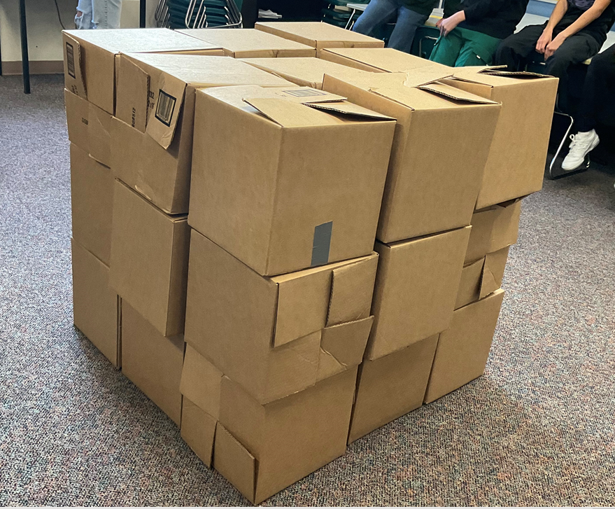
Volume
L x W x H
1 in x 1 in x 1 in = 1 cubic in
12 in x 12 in x 12 in = 1,728 cubic inches
1 ft x 1 ft x 1 ft = 1 cubic ft
3 ft x 3 ft x 3 ft = 27 cubic ft
1 yd x 1 yd x 1 yd = 1 cy
Notes:
How do you figure volume mathematically: Length x Width x Height
A cubic inch would be calculated by what formula? Show off the cube and let the students visualize the size.
How many cubic inches is in a cubic foot? Work the problem and have them come up with the answer of 1,728. Show the students and let them visualize the box that is 1 cubic foot.
How many feet are in a yard? Work the problem on feet to yards. Show them the cubic yard frame so they can visualize how big this is. In Heavy Civil we quantify volume by cubic yards, usually because inches and feet are too small of a volume.

Slide 9
Volume and Weight
Volume
Weight
1 cubic foot of dirt in pounds
1 cubic yard of dirt in pounds
1 cubic yard of dirt in tons
Approx. 75 – 110 pounds
Approx. 2,025 – 2,970 pounds
Approx. 1.01 – 1.485 tons
Notes:
explain that a cubic foot of dirt equals approx. 75 – 110 pounds
Have students calculate what a cubic yard would approx. weigh. Approx. 2,000 lbs
Have students convert the pounds to tons. Tons are a unit of weight that Heavy Civil uses.
Have a student feel the cubic foot box full of sand to understand the weight.

Slide 10
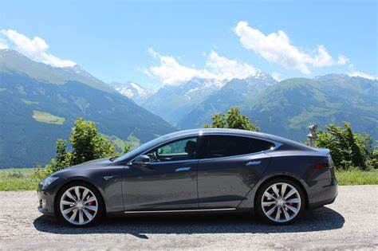
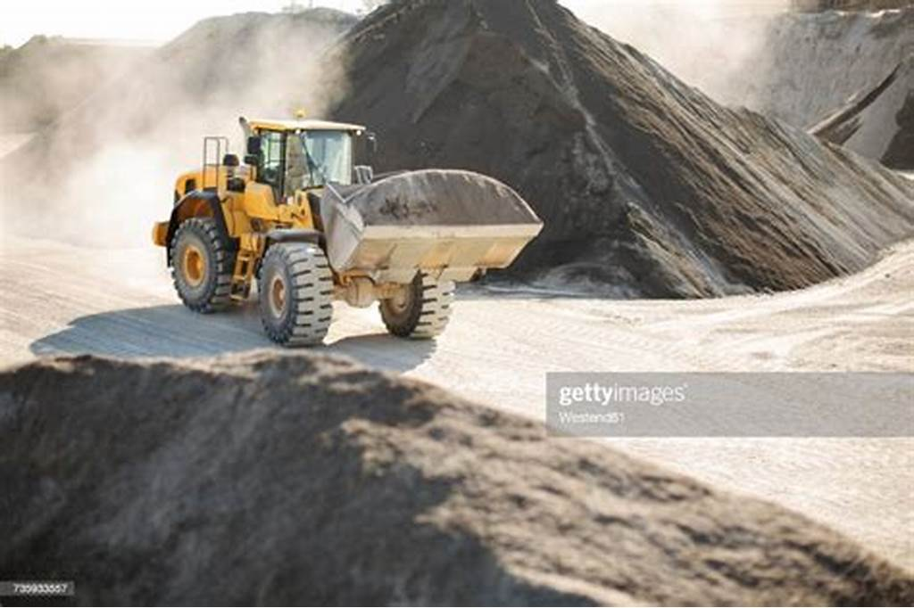

How much do you bench?
Notes:
Typical wheel loader can hold about 8 cyd bucket. This is approx. 17,600 pounds.
A Tesla weights about 4,500 pounds. Thus the loader is packing about 4 Tesla’s in 1 scoop.
The largest African Elephant weighs about 12,000 pounds. Thus the loader is packing a full grown African Elephant and 2 ea. 1 year old calves.

Slide 11

Estimating
Price out “BID” jobs
Historical data
  Similar scopes of work
  Accurate data
  Analyze
Notes:
Give examples of how you would have to price out a job.
1. If you had a summer lawn mowing business and you had to quote a person a price to mow their lawn.
Give examples of how having accurate history data helps you.
1. After you have mowed multiple lawns and tracked the time it took; how could you use that data to help adjust your pricing on future lawns?

Slide 12
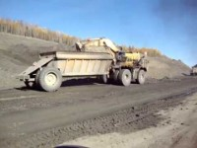
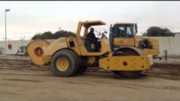
Shop Exercise
Transfer material from a gravel pit to a dump site.
  Load into trucks.
  Haul material to job site.
  Dump truck into job site.
  Compact material (only 2 teams will be allowed)
DO NOT SPILL MATERIAL!!
Document information.
Notes:
Show a couple of videos so students can visualize the types of equipment you are talking about to aid in the vision of the simulation.
Give a brief overview of the rules to the simulation to the entire class.

Slide 13
Instructions
Groups 1 & 3
Groups 2 & 4
Assign personnel
  Project Foreman
  Excavator operator
  Truck drivers (1 - 4 ea.)
  Grade Checker (oversite only)
  Project Engineer (documentation)
Assign personnel
  Project Foreman
  Excavator operator
  Truck drivers (1 - 4 ea.)
  Compactor operator (compaction efforts)
  Project Engineer (documentation)
Notes:
Give more detailed instructions to the Project Foreman and Project Engineer.
Divide teams into 4 groups of 5 - 8 = 20 - 32 students
Explain what is required of each team and the difference between oversite and compaction efforts at the dump site.
Hand out recording sheet to project engineer and foreman explain what needs to be done.
Emphasize the importance of communication and documentation.

Slide 14
BREAK TO SHOP EXERCISE

Slide 15
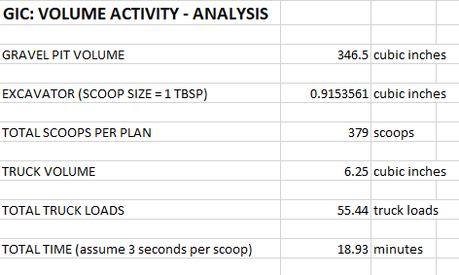
Share Results
How many cubic inches was the gravel pit?
How many total bucket scoops?
How many total truck loads?
What was your total time to transfer the material?
Notes:
Get total time to transfer the material. Document on excel spreadsheet.
Get total bucket scoops used. Document on excel spreadsheet.
Get total truck loads used. Document on excel spreadsheet.

Slide 16
Bank -> swell -> Loose “TRUCK”
Dirt in its natural state = “bank”
When you loosen dirt by disturbance
Grow in size by about 25%
This represents it in a “loose” state or a “Truck” cubic yard
Notes:
Reference how in place ground to put in the back of a truck will swell in size by about 25%
It should have taken exactly 56 truck loads to transfer the material in the shop exercise based on perfect world geometry.

Slide 17
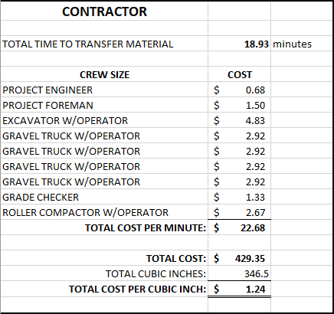
What did we learn?
Did you run out of room at your dump site?
Did you have more room at your dump site?
Why was there a difference in bucket and load counts?
Where were the sticky points or areas that were slow?
What could you have done different to increase production?
Notes:
Discuss with class if they had a shrink or swell.
Discuss why there might have been a difference in the amount of scoops from team to team. Material, scoop size?
Discuss areas where a team had difficulties or slow points. Compaction efforts, haul route?
Discuss what could have made the team more efficient. Bucket size, # of trucks, haul route, compaction efforts?
Share exact math results and explain why documentation and feedback is important in the real world of contractors. This helps the estimators properly price projects because it is more difficult than it appears.

Slide 18


Future Construction Workforce
Notes:
Ruby: talk about how to get into the industry.

Slide 19

Geometry Exercise
Solve for quantity.
  Overburden volume.
  Gravel volume.
Solve for quantity.
  Overburden to build berm.
  Remaining overburden.
Notes:
Hand out and explain the geometry exercise.
Use a real-world project so the students can get a better understanding of the type of work we do.

